Slide 1
For Your Outdoor 4G/5G Superfast Internet Experience + Portable Solar Generator

Slide 2
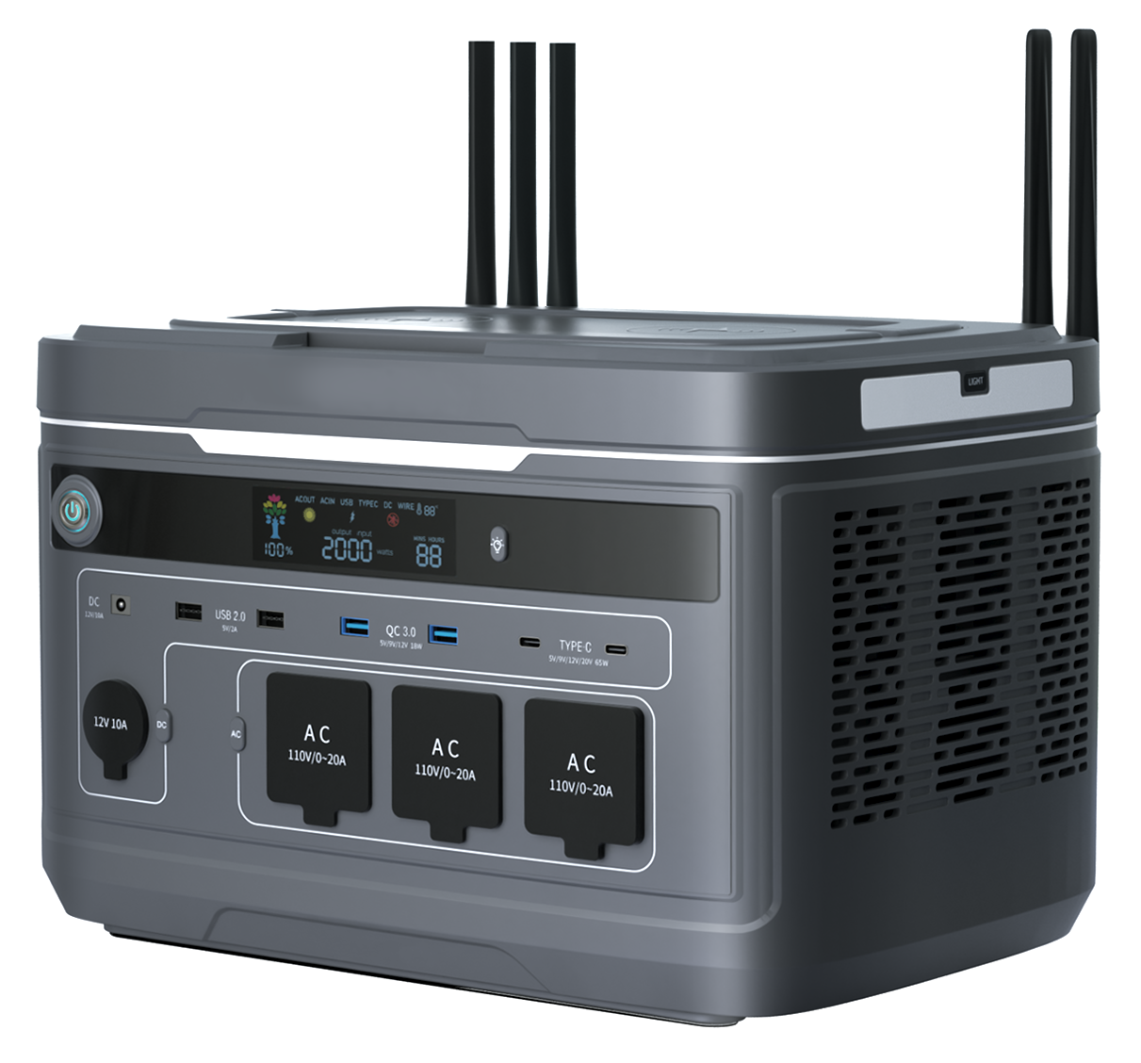
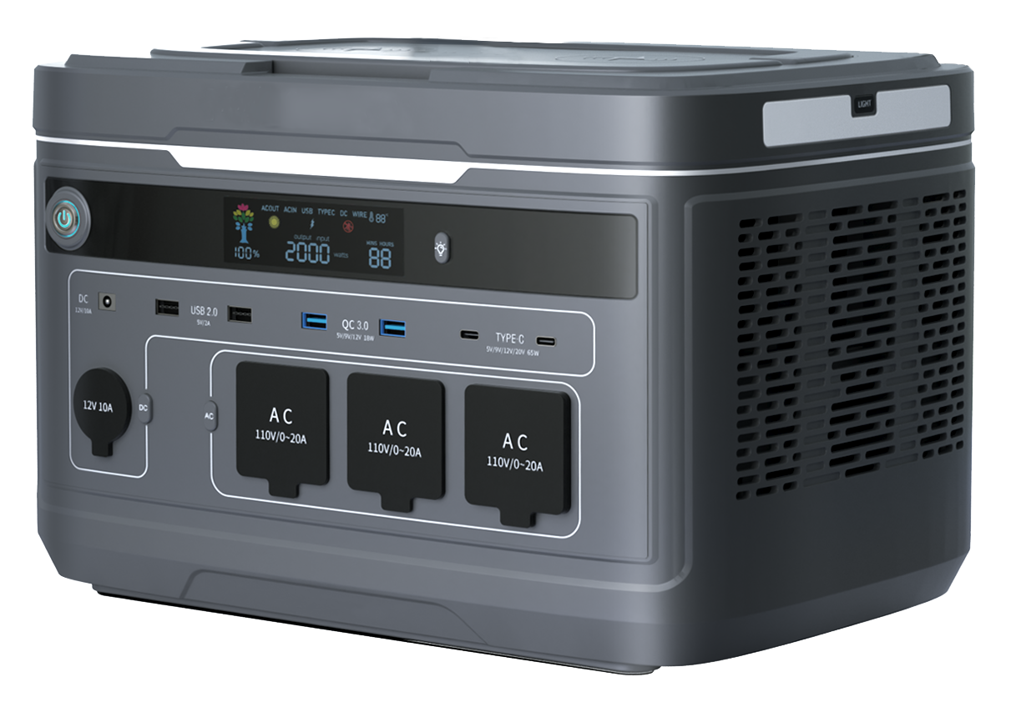
4G/5G WiFi Power Station
Ultra Long Battery Life, 4G/5G High-speed Internet
2016Wh/2300W
2016Wh/2300W
2016Wh/2300W
META-2000 (Standard)
META-2000（4G）
META-2000（5G）

Slide 3
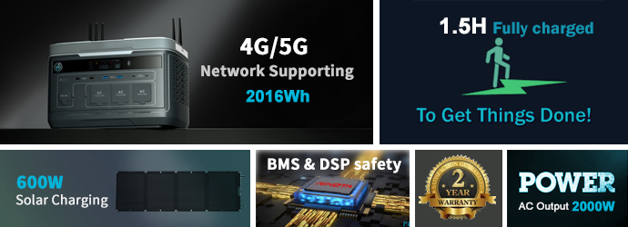
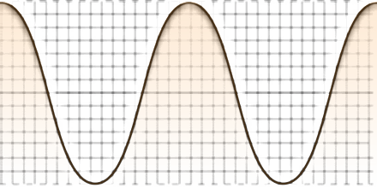
4G/5G WiFi Power Station
WiFi 4G/5G
High Power
Long Life
Security
Wide Applications

Slide 4
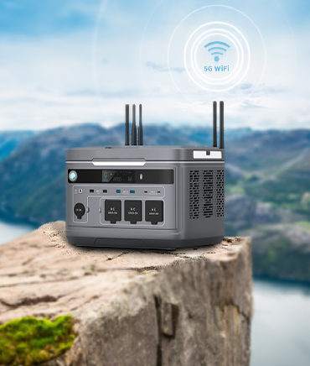
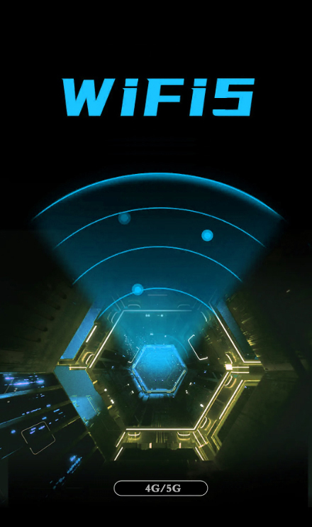
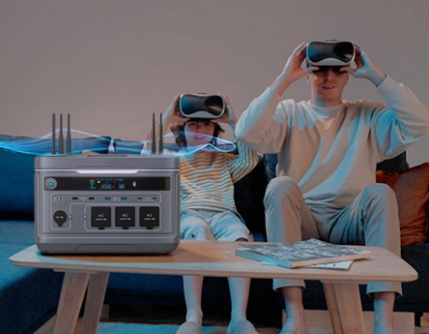
4G/5G
High-speed Access
Outdoor/ indoor WiFi 4G/5G connect，satisfied your office, camping and play anytime anywhere
2 Ways to connect
Method 1：Insert a SIM Card, it can support wireless WIFI and LAN connection
Method 2：Cable insert WAN port, it can support wireless WIFI and LAN connection

Slide 5
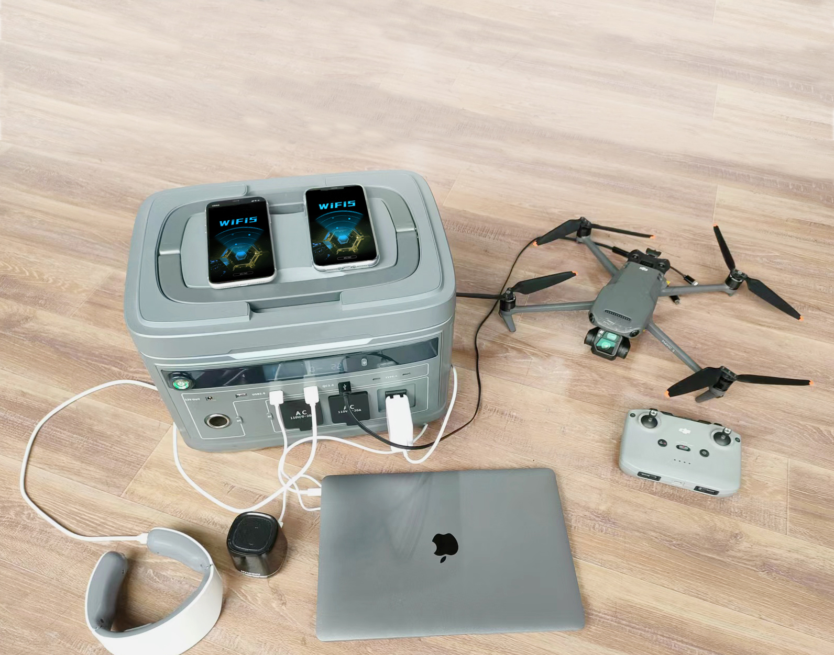
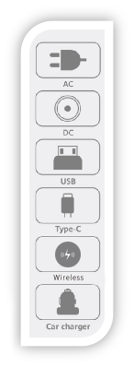
Multi Device Adaptation
Plug and Play
Diversified ports, compatible with the power demand of household appliances, office equipment, professional equipment, etc
Support multiple AC output
UK
EU
CHN
AU
US
JP

Slide 6
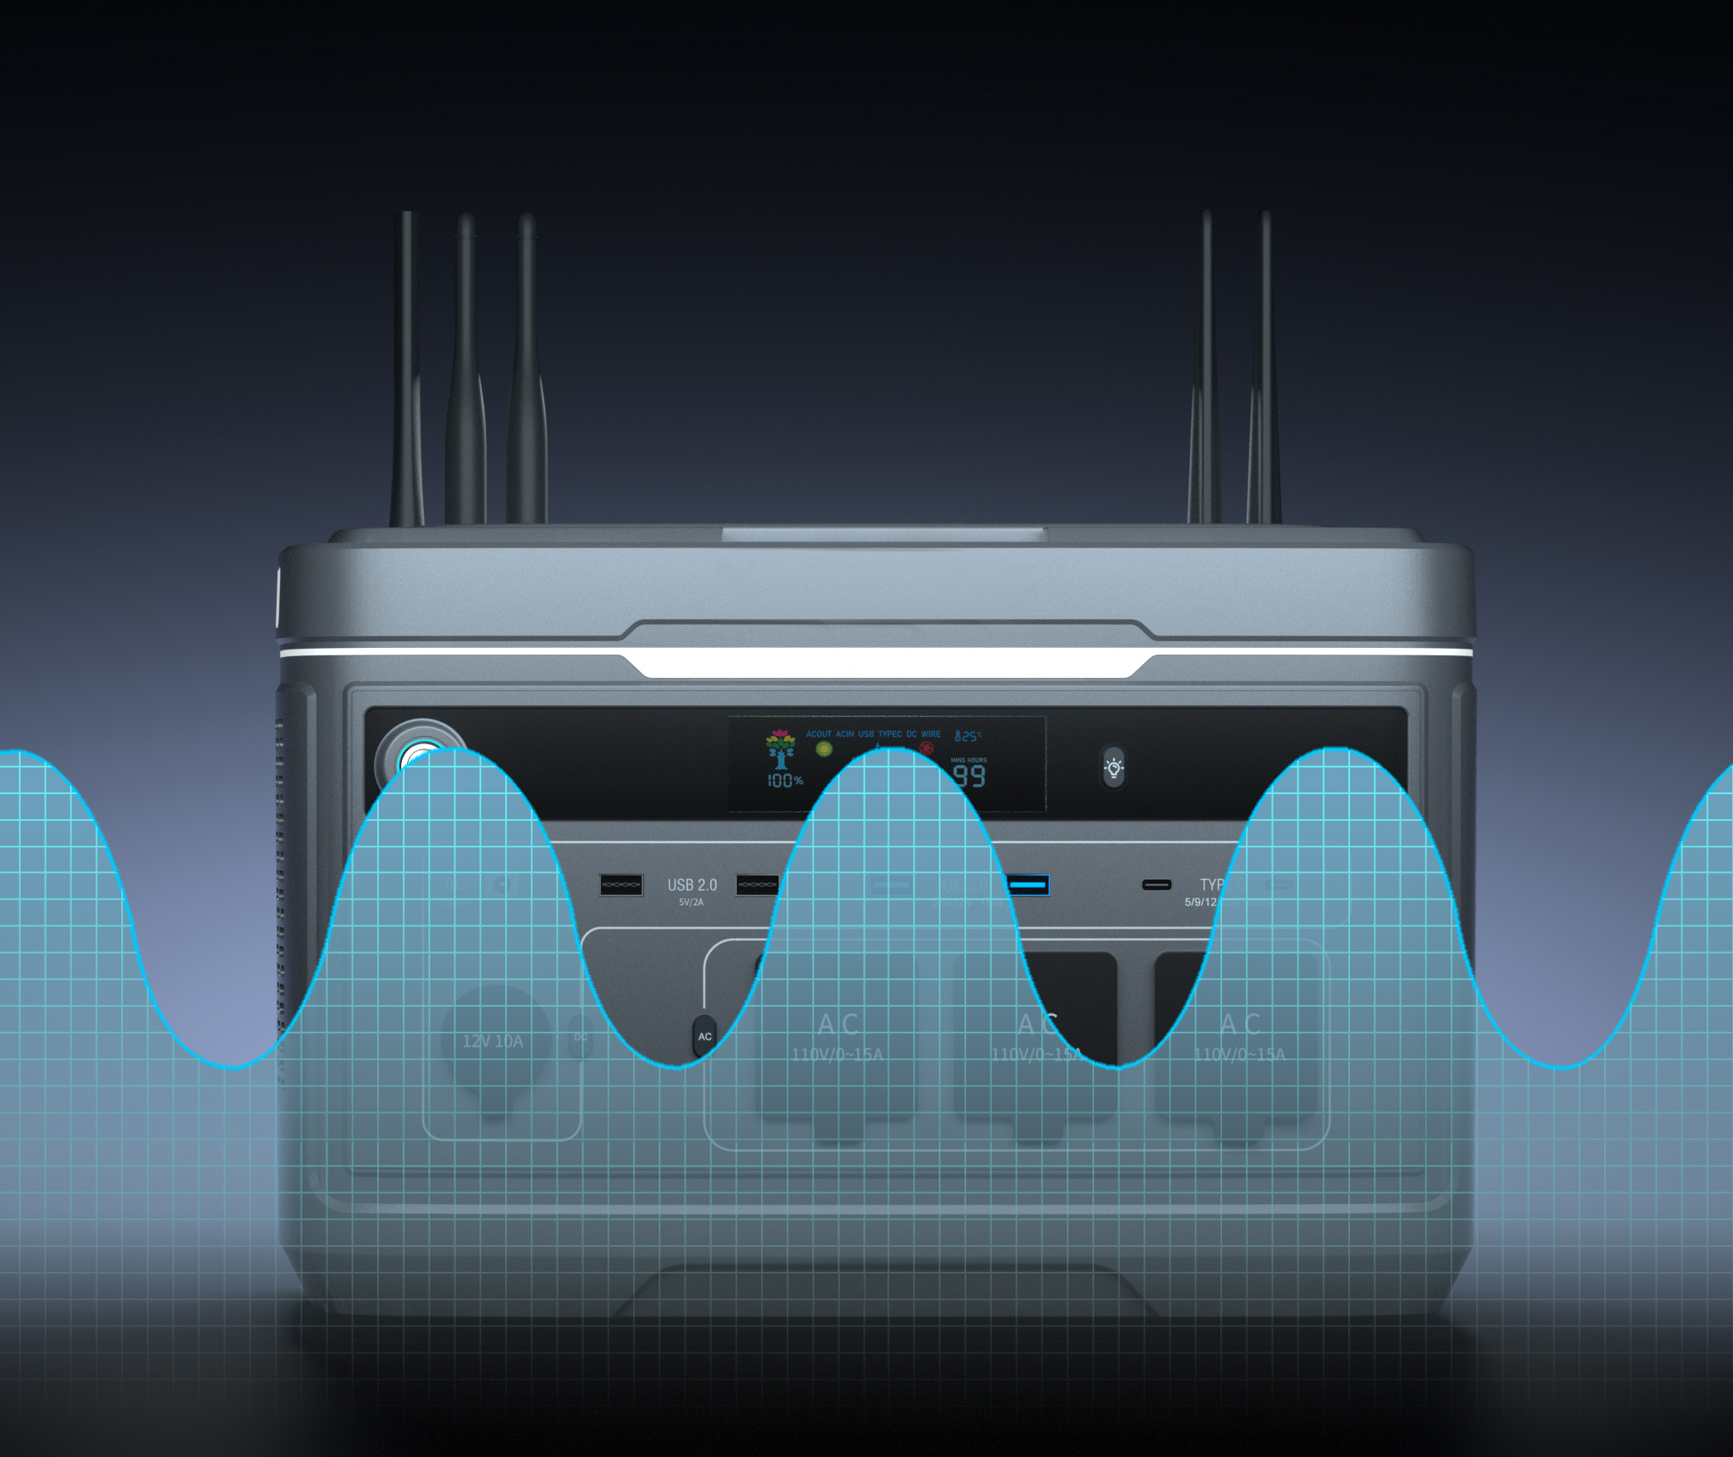
Stable Output
No Damage
Sine wave output does not damage
the appliance
Sine wave output
Bidirectional Technology
Smart Control Output

Slide 7
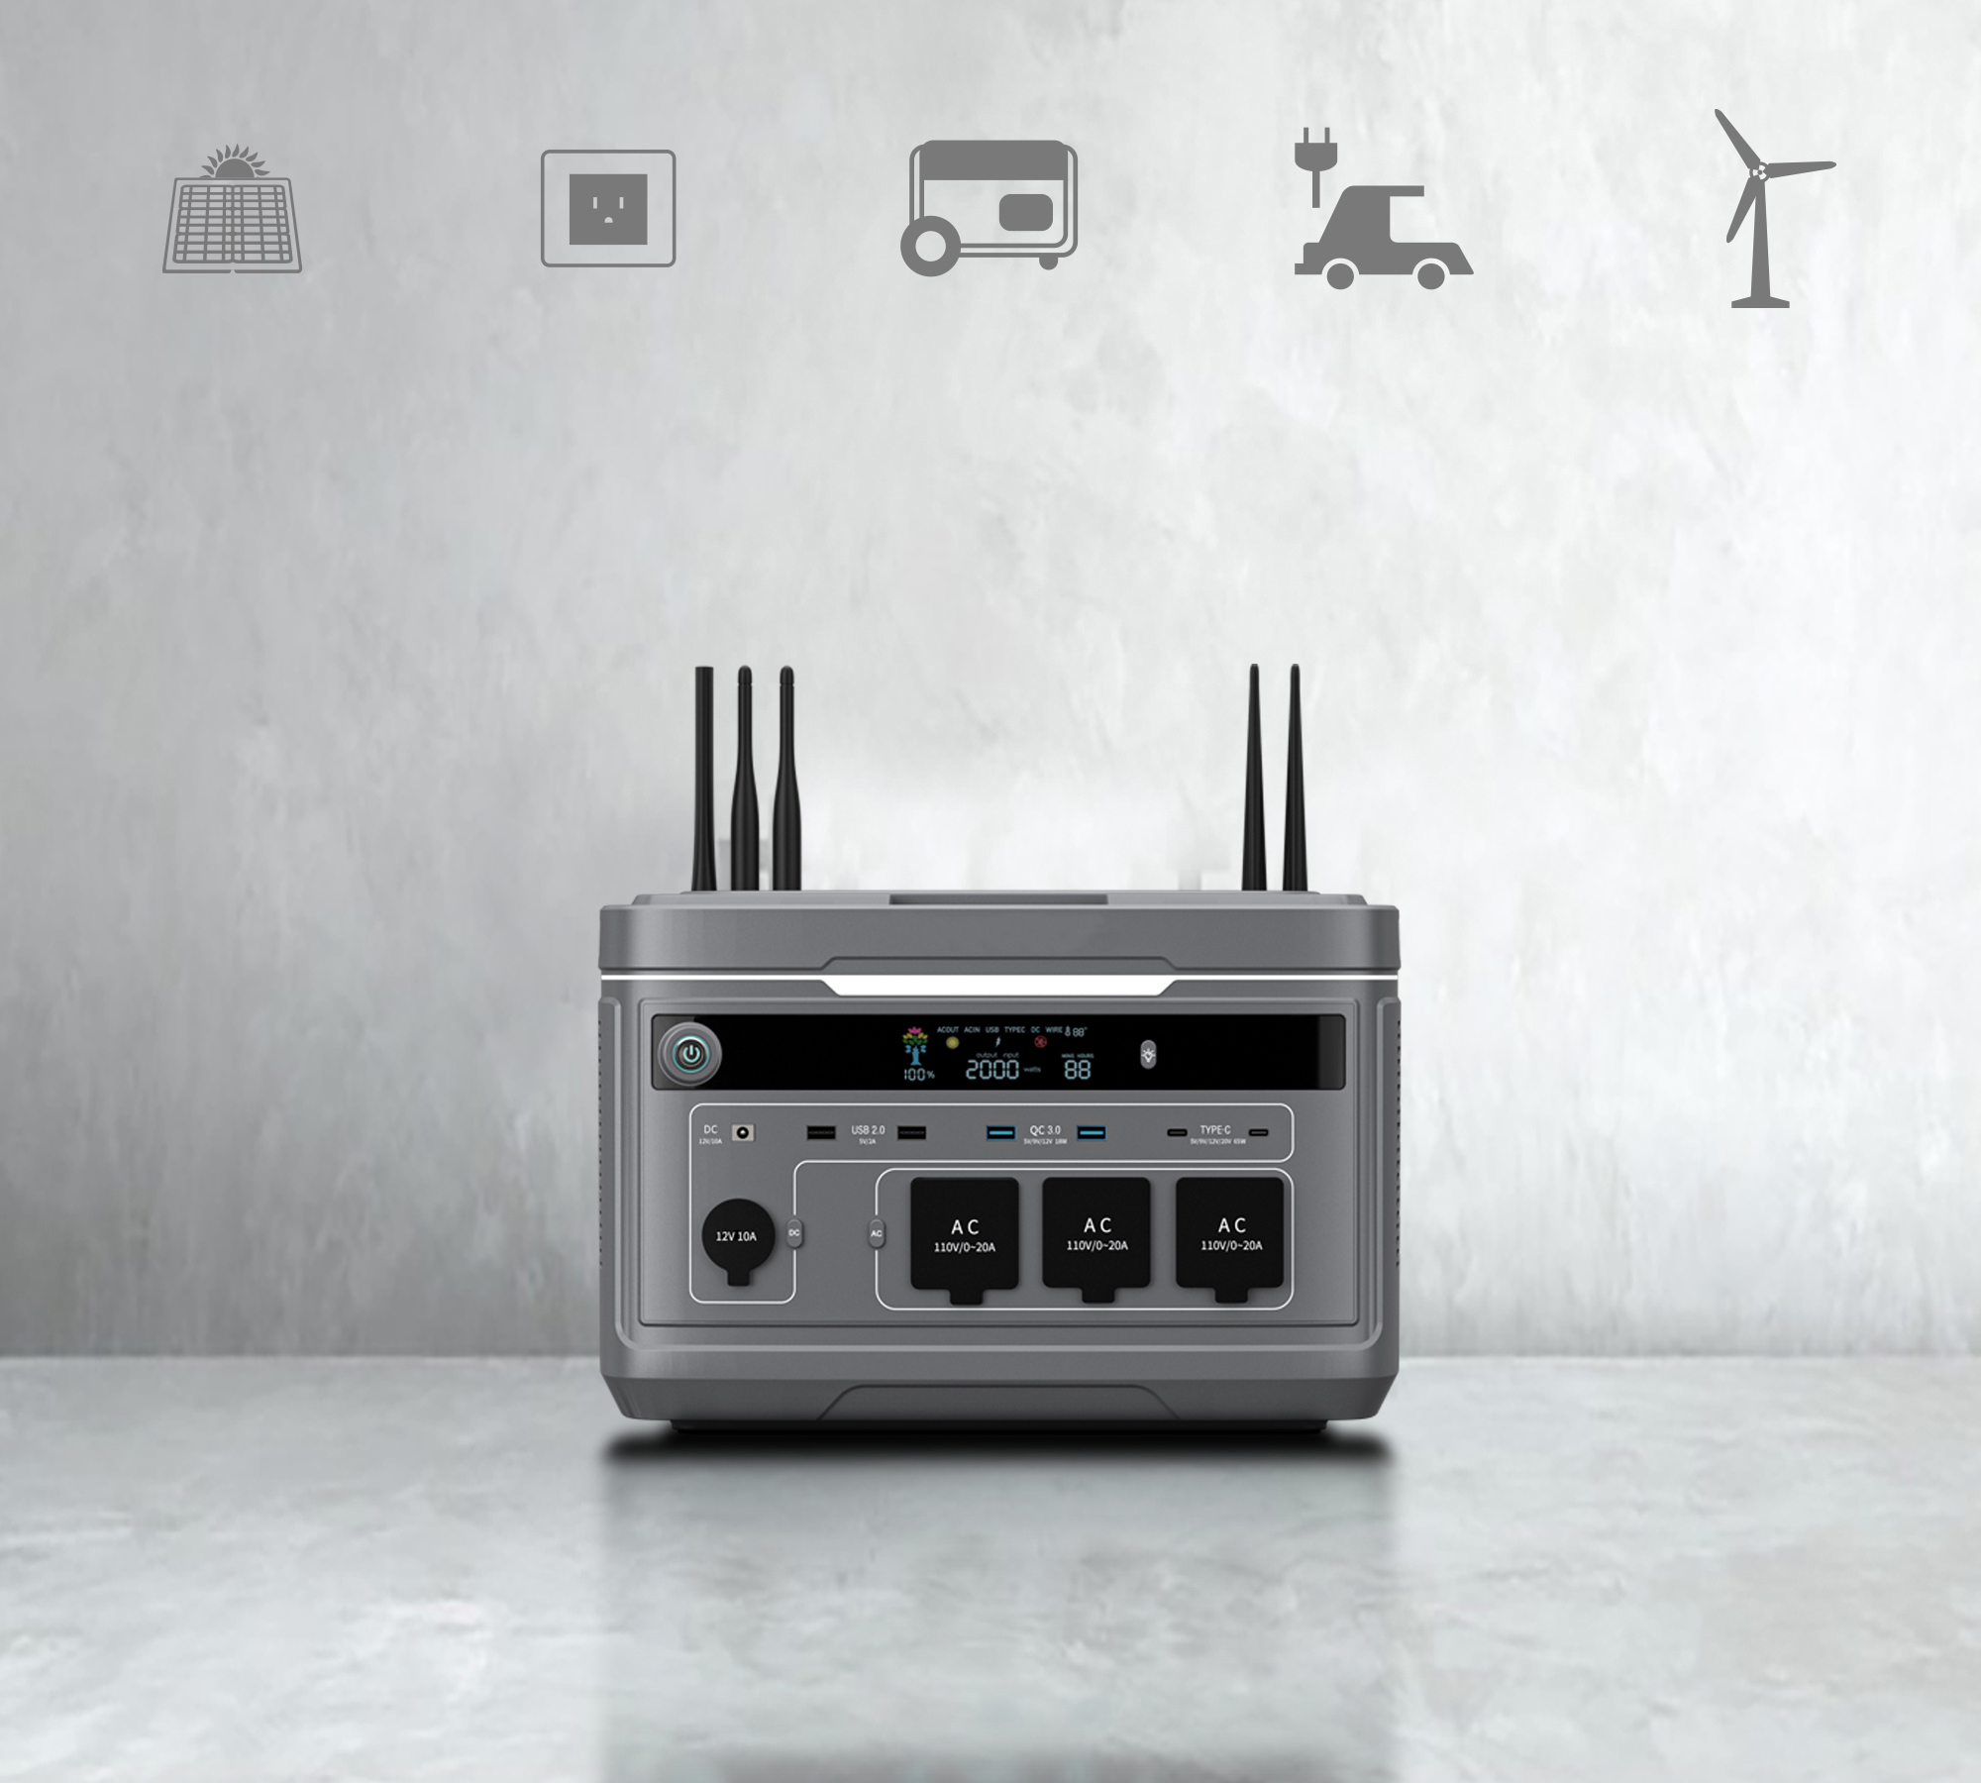
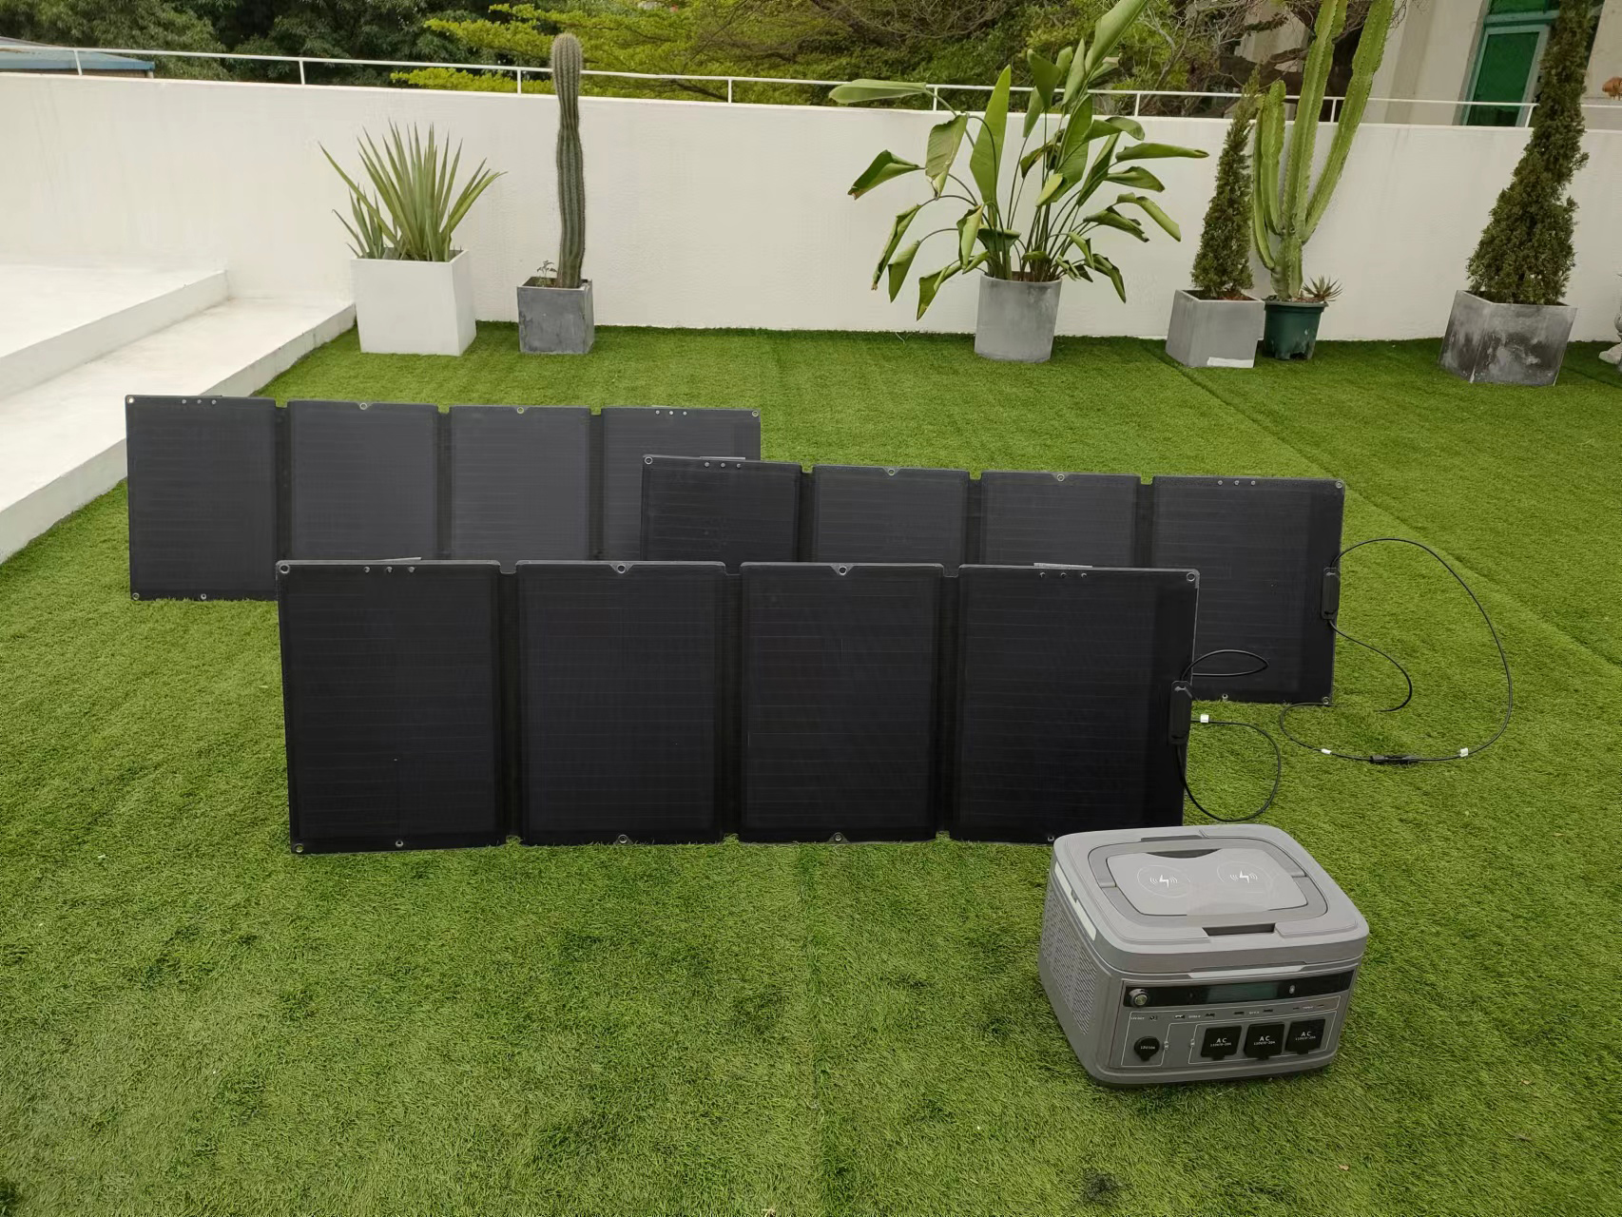
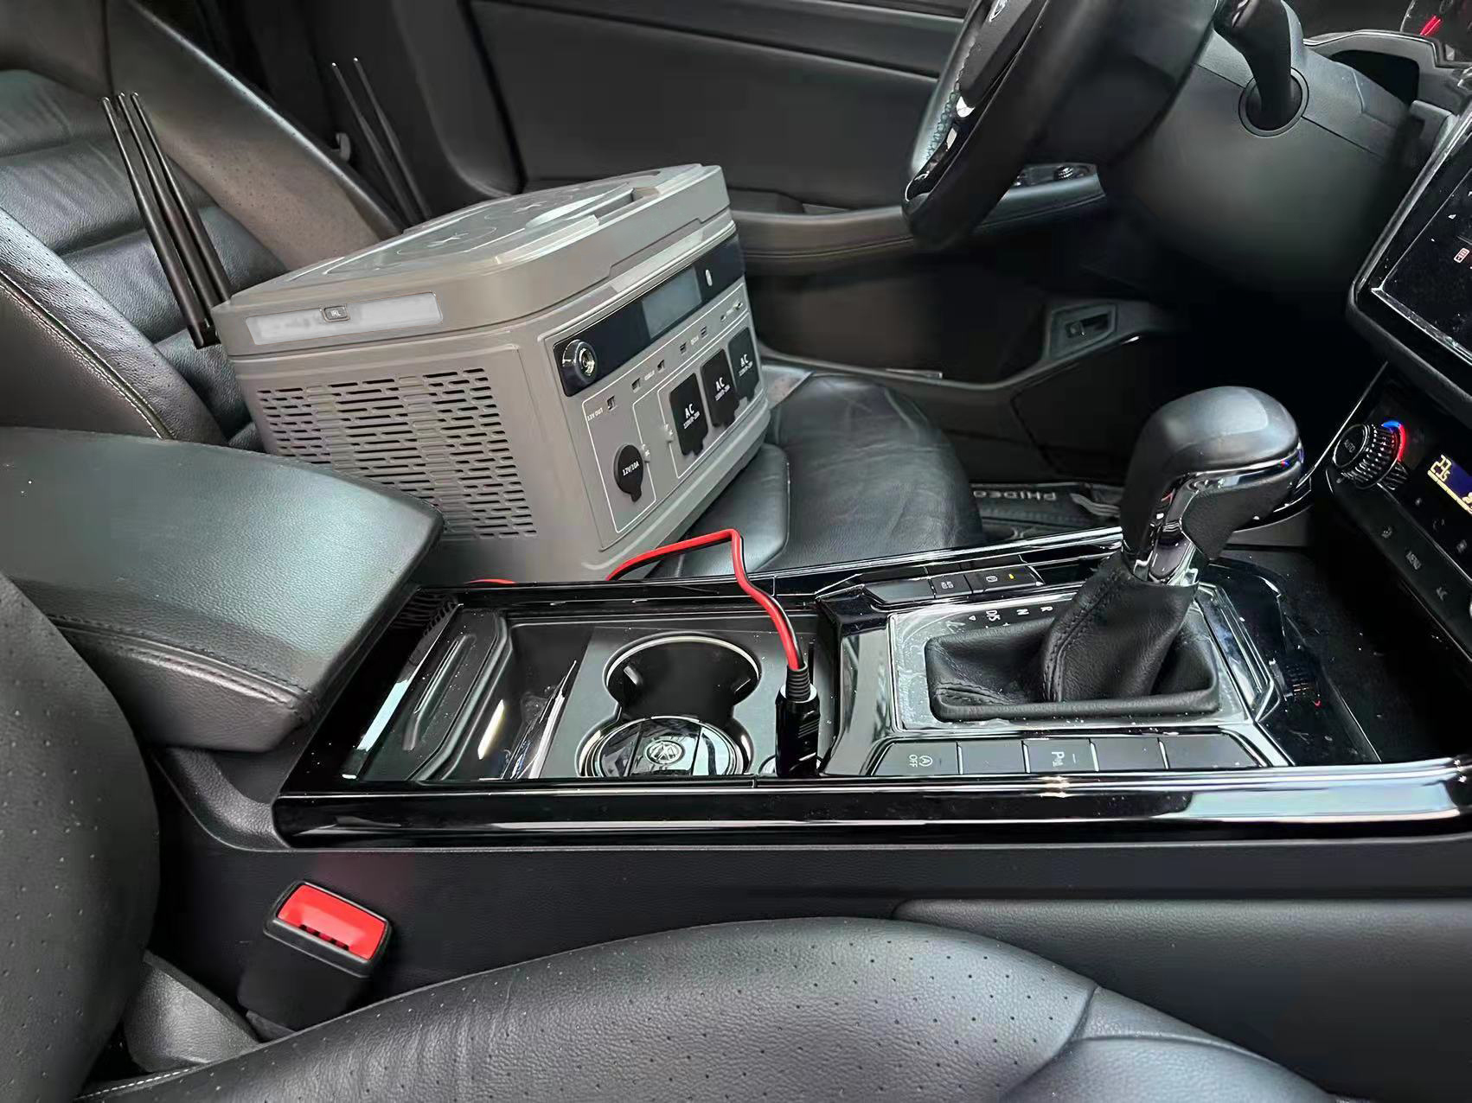
5 Ways
Flexible Charging
5 charging modes, flexible charging,
keep you full of power outdoor
Solar Charging
600W
Wall Charging
2000W
Gas Generator
2000W
Car Charging
2000W
Wind
Turbine

Slide 8
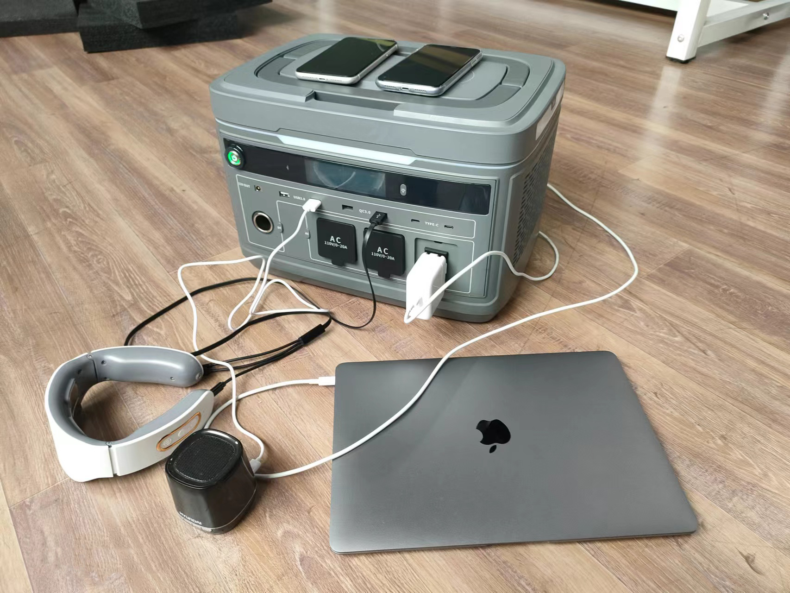
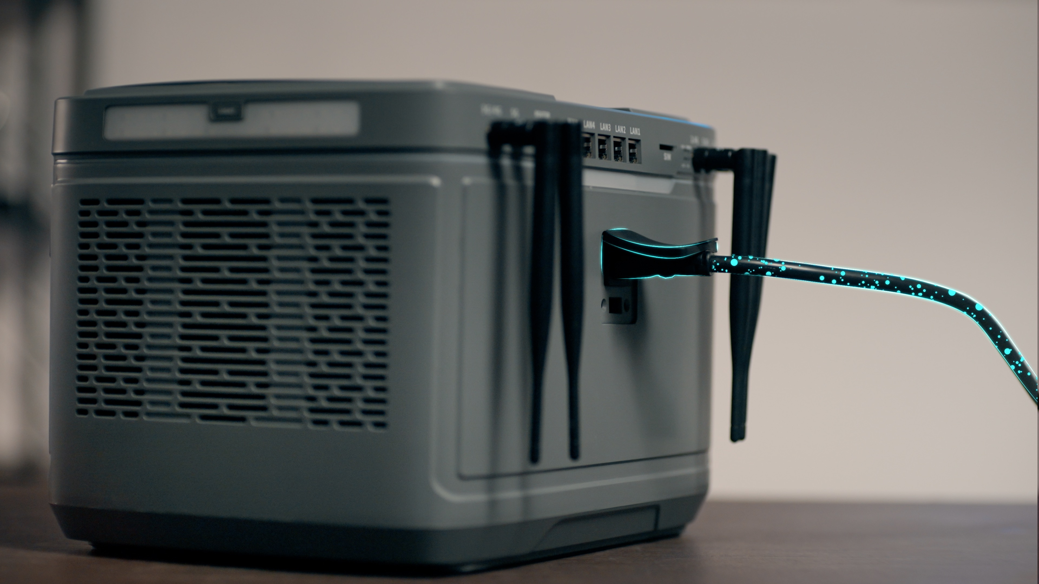
Fast Charging
One Step Faster with Electricity
Efficient and diverse charging and discharging modes, no need to wait
High Efficient MPPT
MPPT efficient can reach 95%
Pass through
Charging and discharging without waiting
Fast charging
Be fully charged in 1.5hs

Slide 9
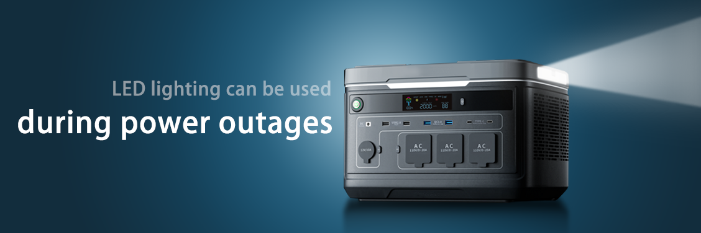
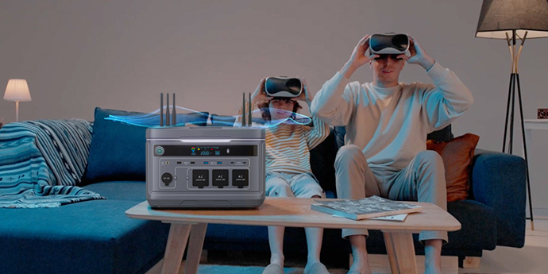
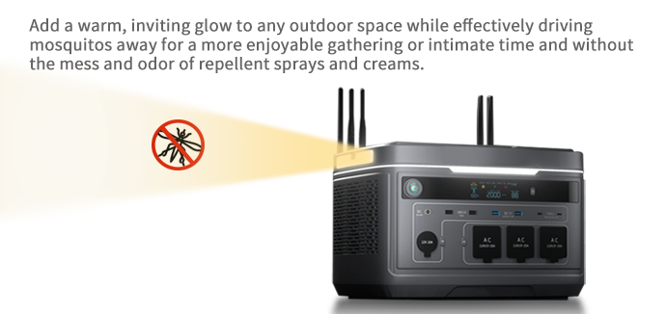
Atmosphere Light
Mosquito Repellent Light
LED light
（Strong light - Light - SOS）
add a warm glow to any outdoor space while effectively driving mosquitos away for a more enjoyable time and without the mess and odor of repellent sprays and creams.

Slide 10
Bidirectional Inverter
Intelligent Temperature Control
Intelligent transformation between
AC and DC to ensure the stable output of current
Battery +Inverter Technology
The built-in bidirectional inverter of the NIKOTA META-2000, it enables the Marina adapter-free fast charging technology. With this sleek, light-weight charging cable, you can power just about anything without an adapter.
Intelligent Temperature Actvated Fan
Smart temperature control keeps the META-2000 cool,protecting the battery.6low-noise fans only start at 45 degrees Celsius. The META-2000stayed quiet overmnight when using a CPAP machine.
UL certified automotive power cell
Class V-0 flame retardant enclosure
6 intelligent temperature control fans
Aviation grade aluminum alloy frame

Slide 11
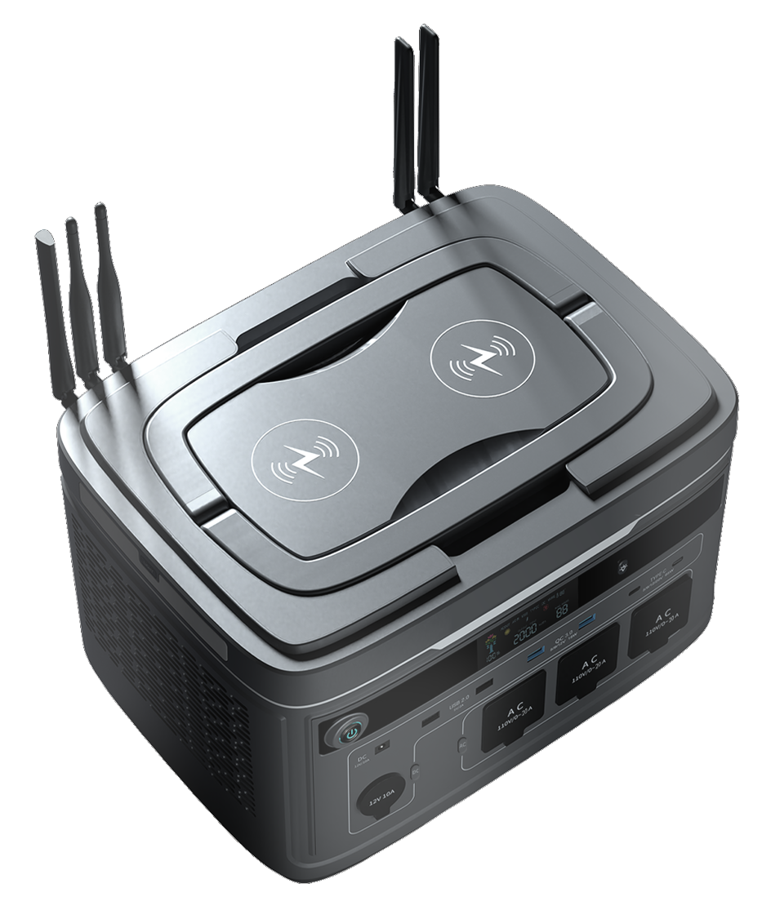
Safe & Durable
Multiple security protection,
UN38.3 CE certification,
100+ quality test verification
4 safety test
Vibration Test
Drop Test
Crush Test
Impact Test
8 security protect保护
Short-circuit
protection
Over-current
protection
Over-voltage
protection
Low-voltage
protection
Over-load
protection
Over-temperature
protection
Over-charge
protection
Over-discharge
protection

Slide 12
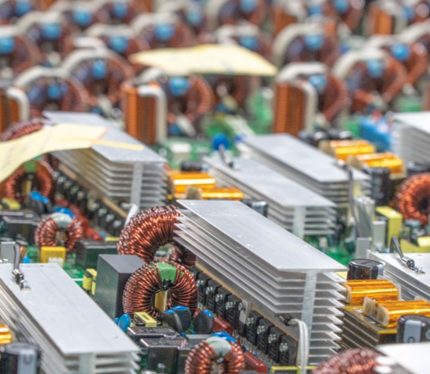
9 Quality Inspection
Strict process makes you feel safe
IQC
Incoming Quality Control
Cell Capacity Sharing
Cell Test
PCBA
PCBA Test
Semi-manufactures
Test
Aging Test
QA
Final Test
Final Product Inspection
Spot Check

Slide 13
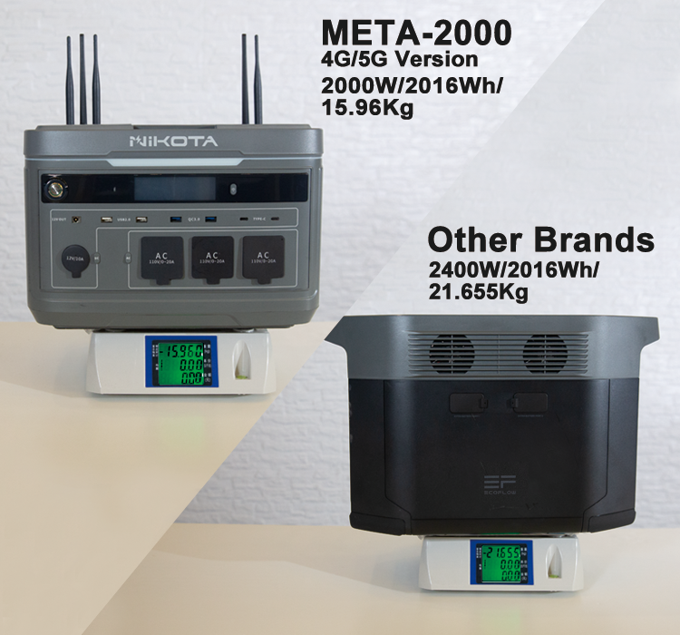
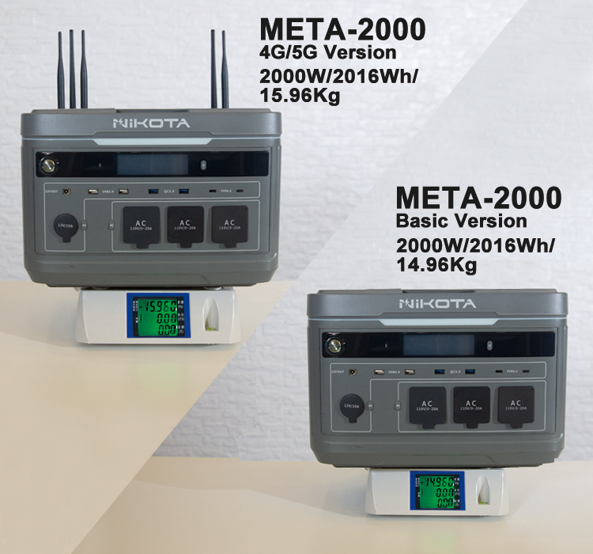
Whenever and Wherever Possible
Portable Power Station
Small size, light weight, convenient and portable, ergonomic design

Slide 14
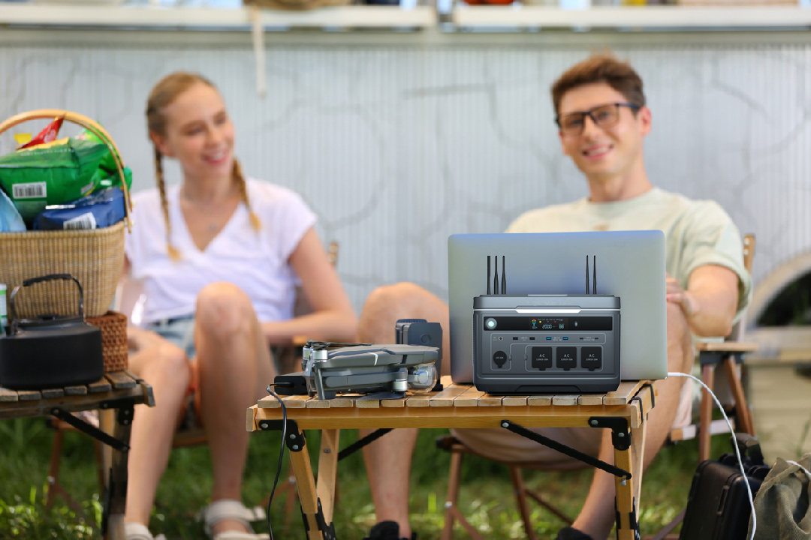
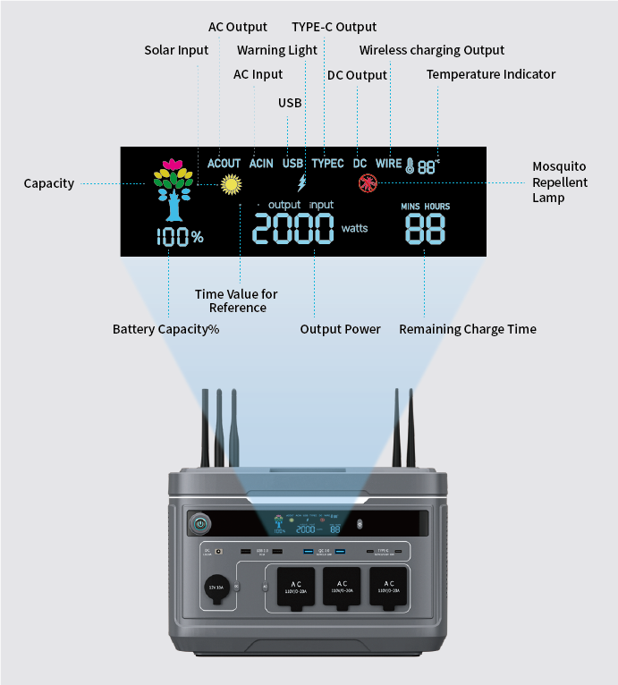
Real Time Digital Display
State of charge
Easily experience outdoor
entertainment and life

Slide 15
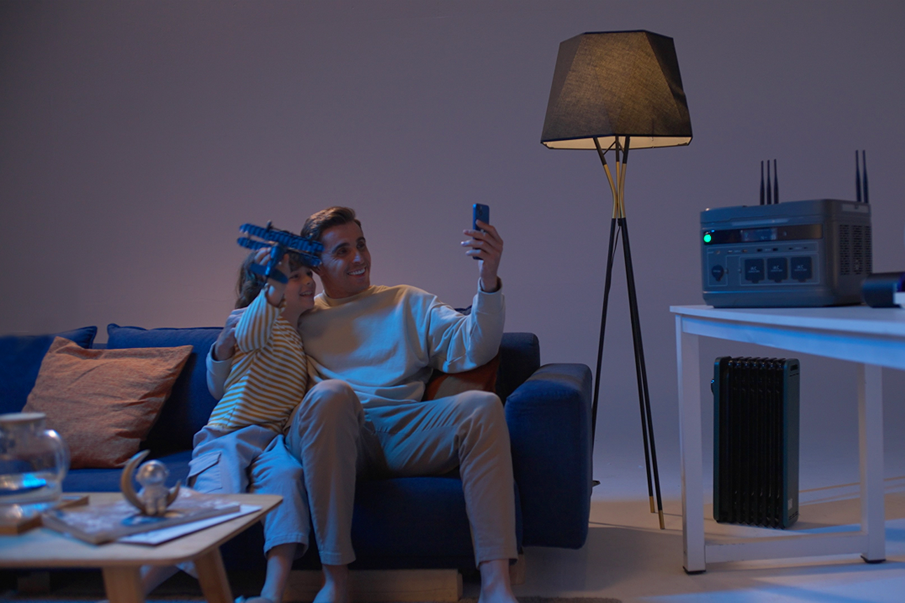
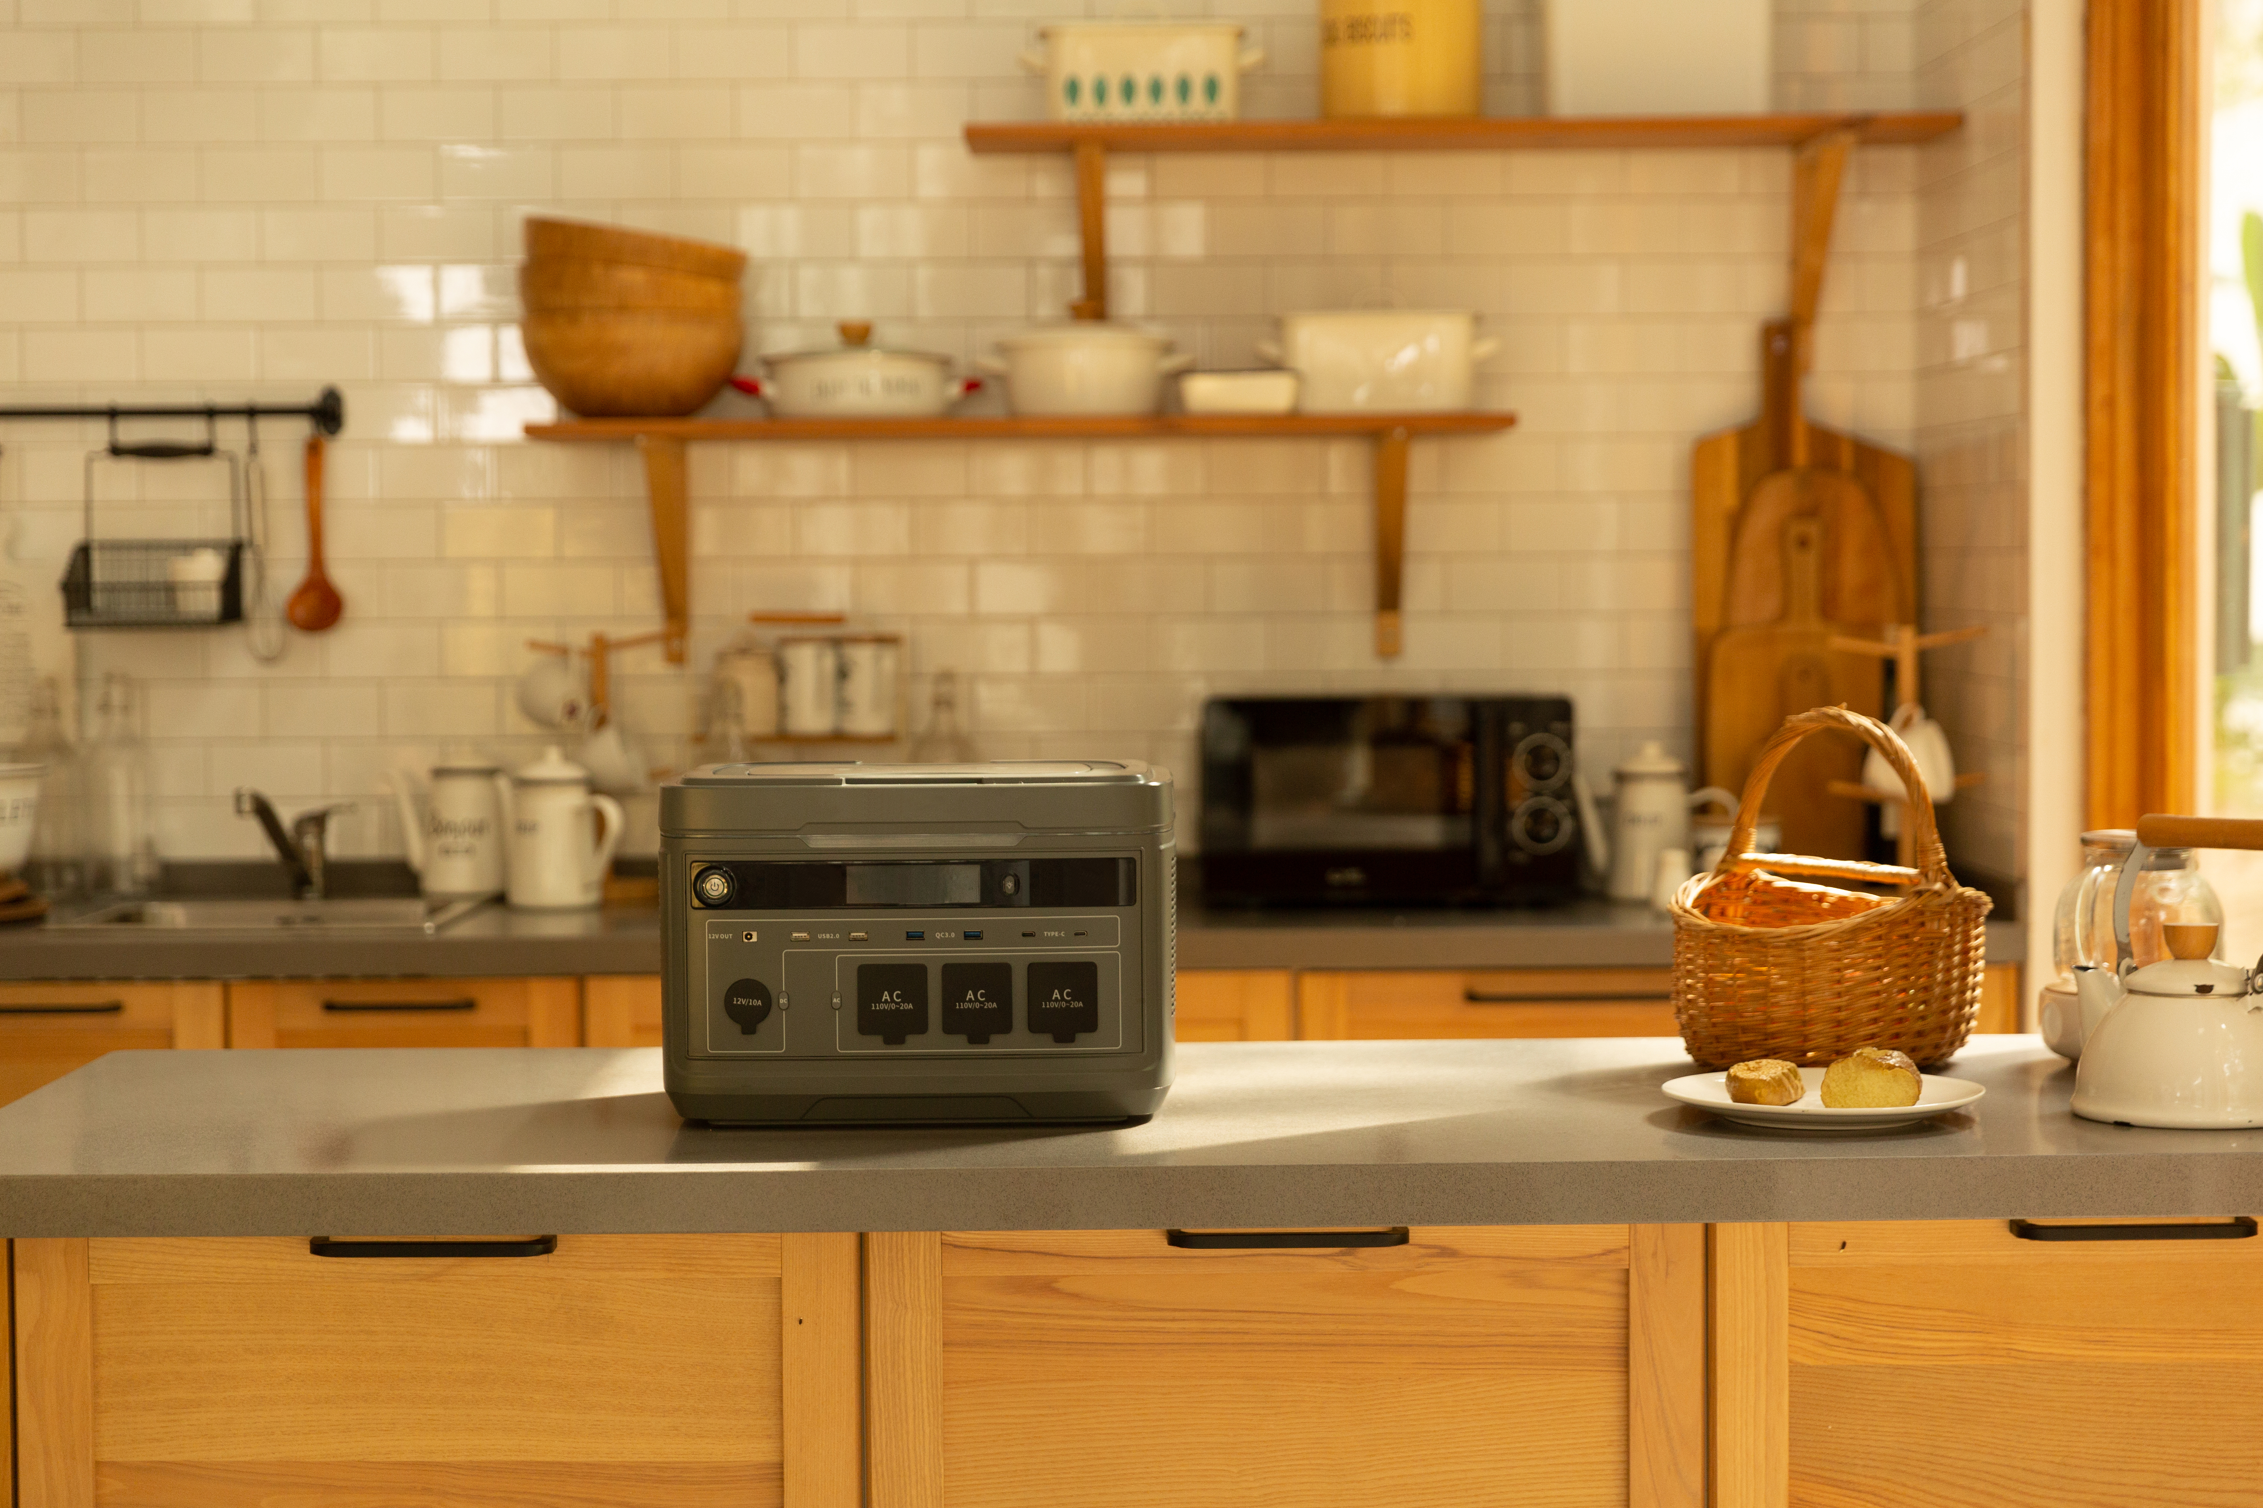
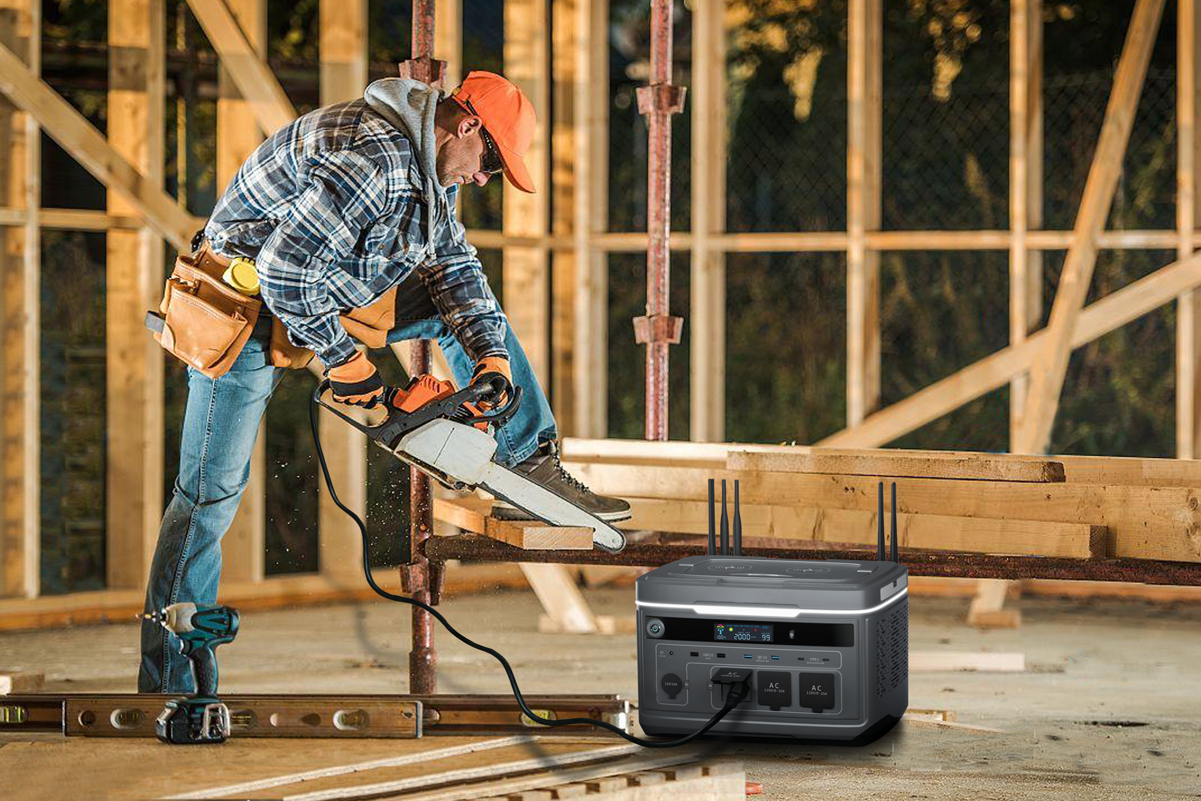
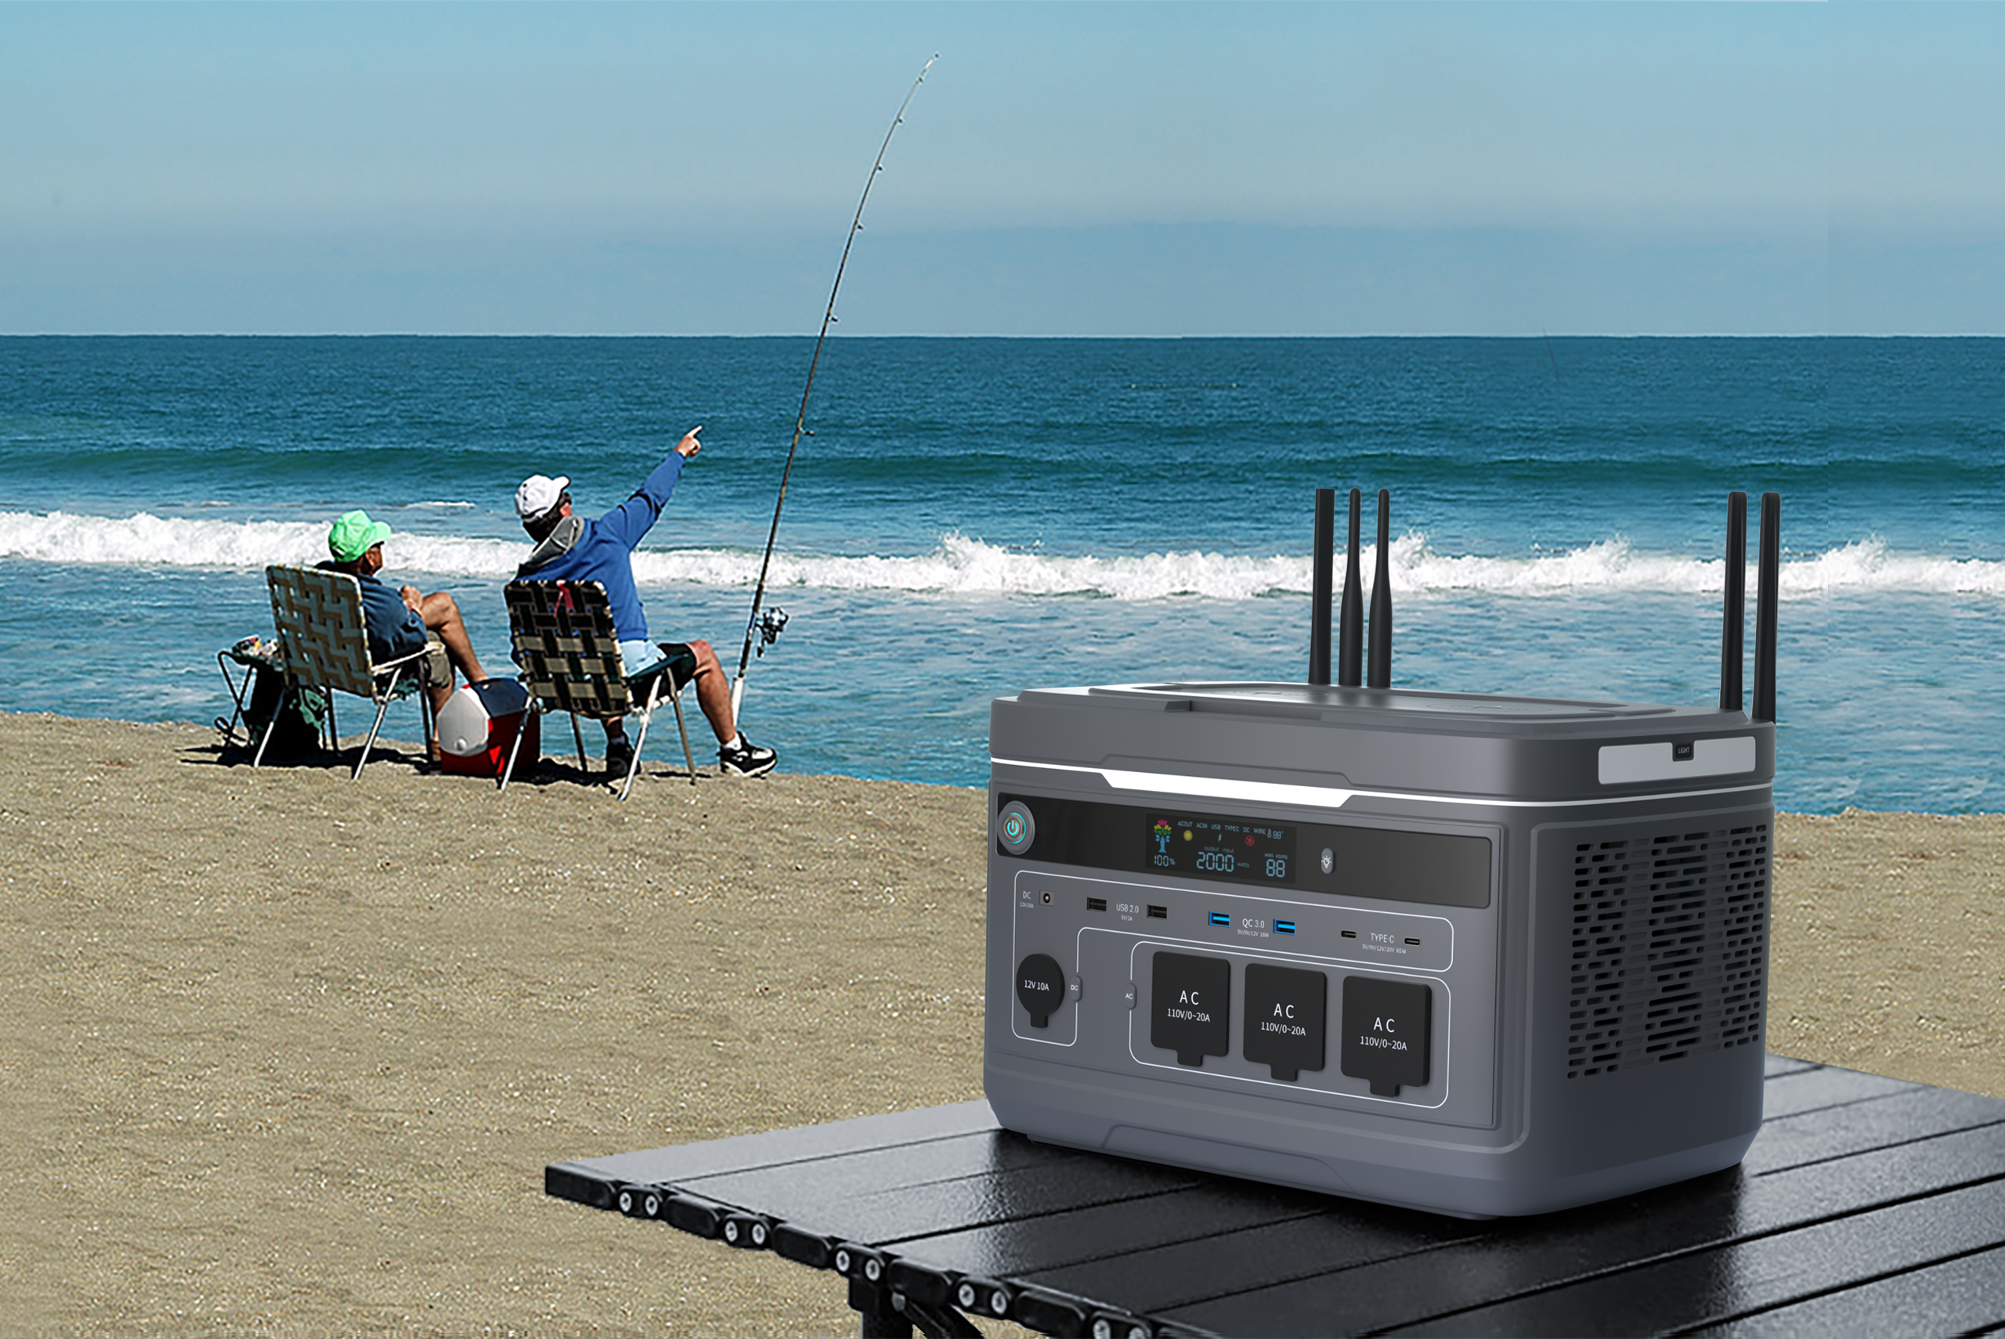
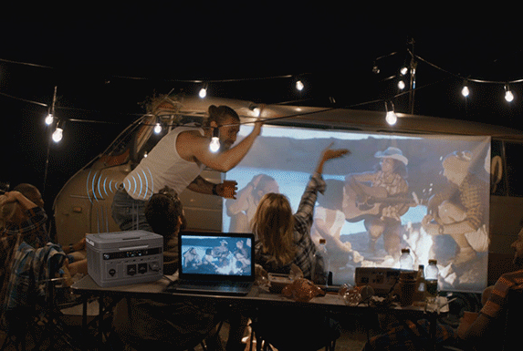
Home
Shops/ Restaurants
RV
Applicable to Multiple Scenarios
Outdoor work
Driving
Camping

Slide 16
2016Wh
Motive Power
Support your outdoor activity
Charging time reference：
≈1.9h
Coffee Maker (1000W）
≈1.15h
Air Conditioner
(1500W)
≈1.3h
Microwave
(1300W)
≈39 times
Laptop
(49Wh)
≈1.1h
Hair Dryer
(1200W)
≈12h
TV
(110W)
≈127.7 times
Smart Phone
(15Wh)
≈64h
Refrigerator
(65W)
≈94 times
Camera
(16Wh）
≈1.2h
Circular Saw
(1400W)
≈38 times
Drone
(40Wh)
≈19h
Projector
(100W)
*The data is from laboratory, only for reference.
Notes:
手机*3.7*0.8

Slide 17
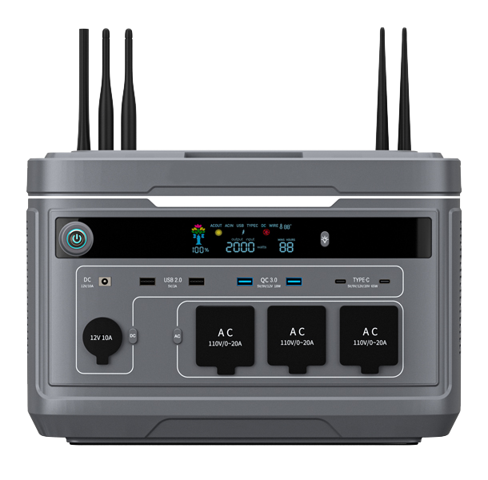
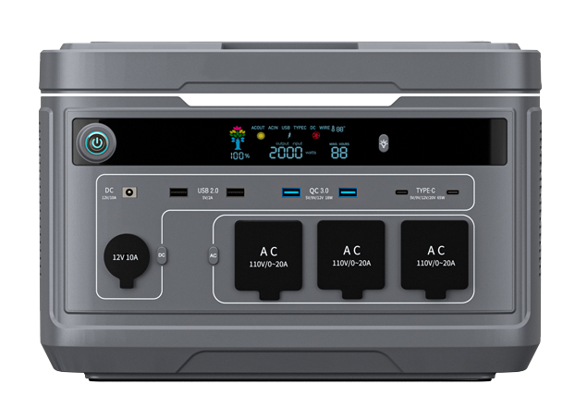
Specification
Standard 4G 5G
WiFi+Router Suporting
Capacity
Dimension
Weight
LED Light
Mosquito repellent lamp
Warranty
AC Output
DC Output
Car Outlet
Wireless Output
Utility Power
Solar Charging
Car Charging
EV Charging
Battery Chemisty
Discharge Temperature
Charge Temperature
Cell Type
×
√
√
4G 5G
2016Wh
37.3*24.9*26.9cm
33.1lb(15kg) 35.3lb(16kg) 35.3lb(16kg)
2 Years
3×Outlets：2300W Total, 110V Surge 4000W; 2300W Total, 220V Surge 4000W
2×USB-2.0 5V/2A 10W; 2×QC3.0 5V/9V/12V 18W; 2×Type-C 5V/9V/12V/20V 65W; 1×DC5525 12V/10A
12V/10A
15W× 2
2300W Total
600W Max,11-42V MPPT
12V/24V/10A
2300W Total
NCM
-20℃~50℃
0℃~45℃
21700
General
Output
Input
Battery

Slide 18
Thank You.
Keep You Powering Up!
Copyright© YIWASHI Technologies Co., Ltd. All Rights Reserved.
Our core team of YIWASHI comes from Huawei and Emerson Network Power. We have Jeen, one of the developers of DSP chip, and Arace, an experienced power engineer and senior member in IEEE, as founders of NIKOTA.
“With our own profession, we can create better way for human beings to use green energy” is the mission of our company. We has resolved to make breakthroughs and redefine green energy in power station industry. In the past several years, we have bent ourselves to revolutionize technology and deepen understanding of customer needs.
Unremitting efforts finally has been paid off and now META-2000 comes into our sight. It sets new golden standards and leads a new trend in power station industry. We believe META-2000 will not be the only product of our company. Based on our team as a strong support, we have confidence to develop more high-performance clean energy products.

