Slide 1
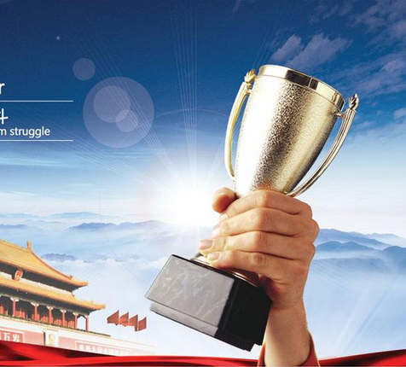
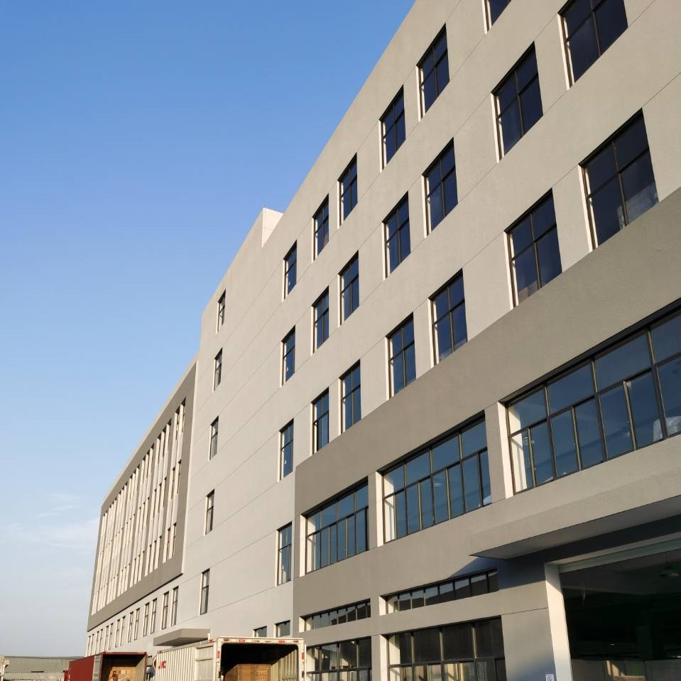
NINGBO WAH HOI ANIMATION TOYS CO.,LTD
FOCUS
RIHOROUS
Introduction of Equipment
INNAVATION
QUALITY
PURSUE
SERVICE
SINCERE

Slide 2
EQUIPMENT LIST
——CONTENTS——
01
02
03
04
Printing Equipment
After-printing Equipment
Die-cutting Equipment
Auto-packaging Equipment
05
The Other（Injection，Tin box，Game card）

Slide 3
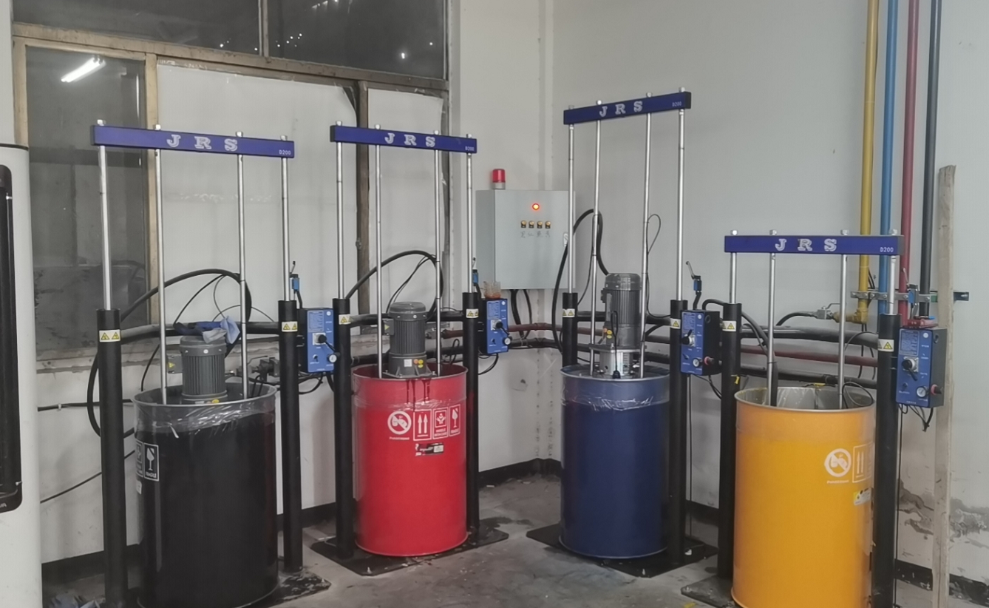
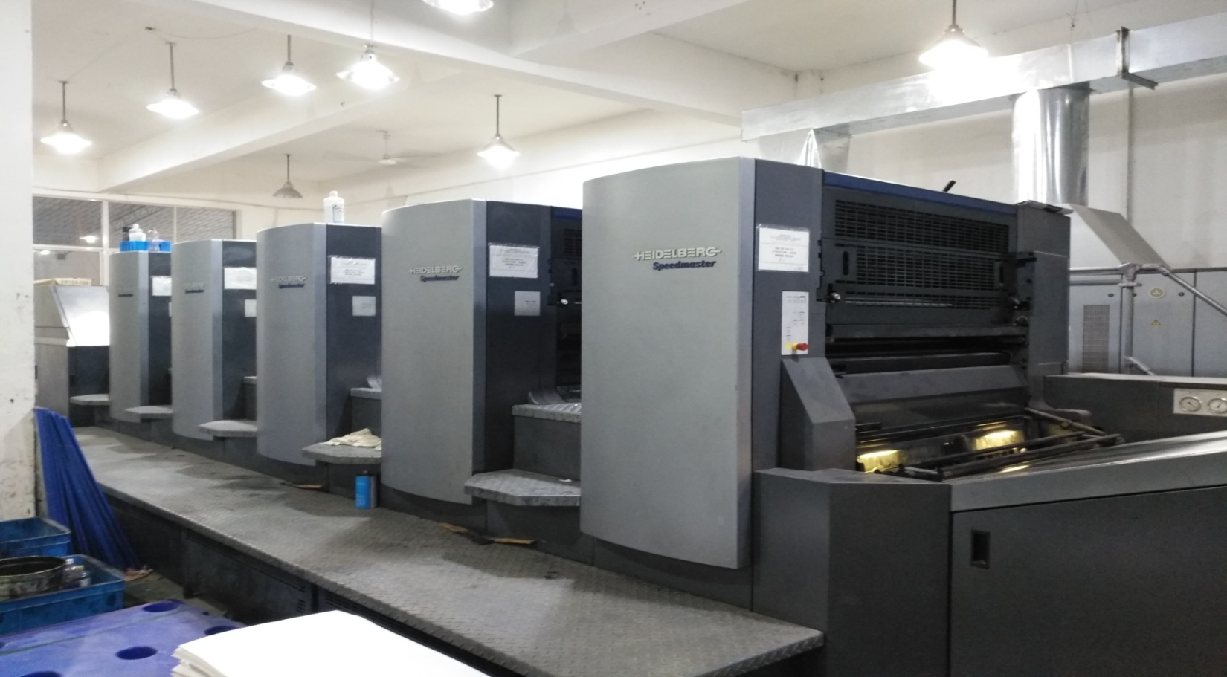
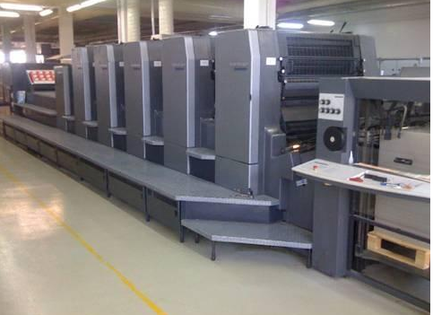
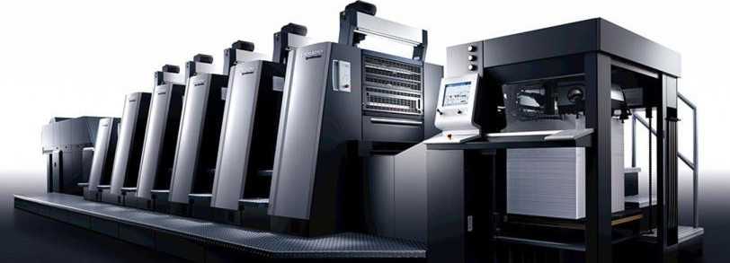
Printing Equipments
Heidelberg off 5+1printing machine
Heidelberg off 5 printing machine
Heidelberg quarto 5 printing machine
Heidelberg Printing Machinery Co., Ltd. is the leading solution provider in the printing media industry, and has accounted for more than 40% of the global sheet-fed printing press market. Heidelberg, headquartered in Heidelberg, Germany, takes the entire production process and value chain of the sheet-fed offset printing process as its core. The format of the equipment covers a variety of practical options.。At the same time, all three printing presses are equipped with JRS automatic ink supply system.
Advantages: The JRS ink supply system can strengthen the color allocation, make the color uniform, and at the same time eliminate the risk of secondary pollution of the ink.

Slide 4
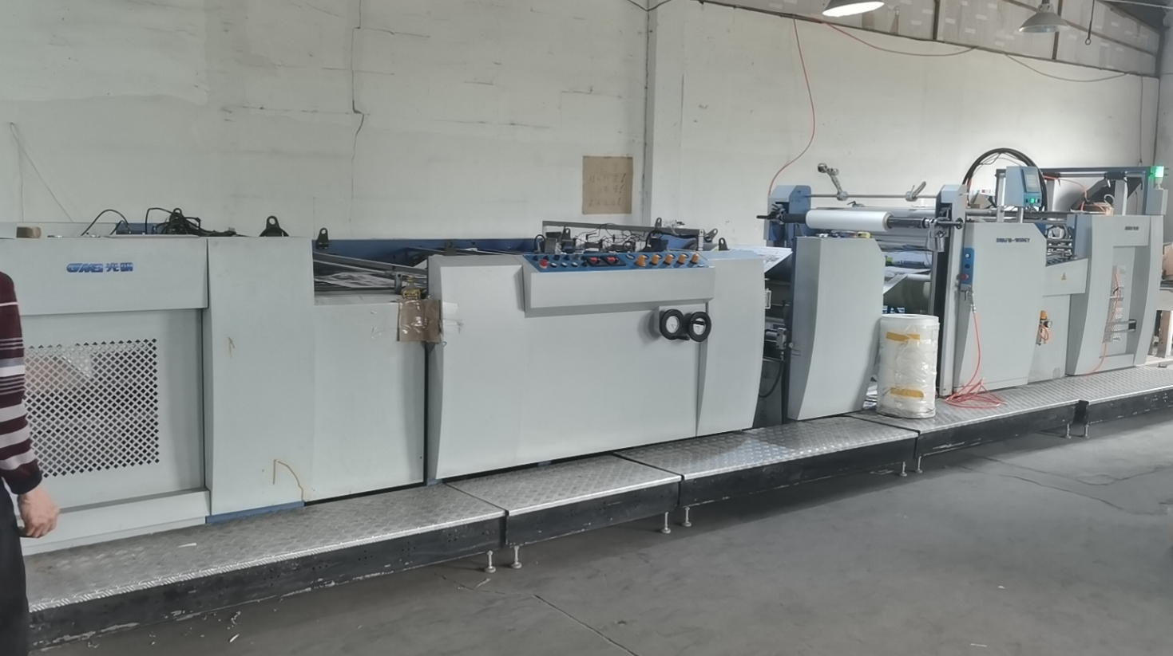
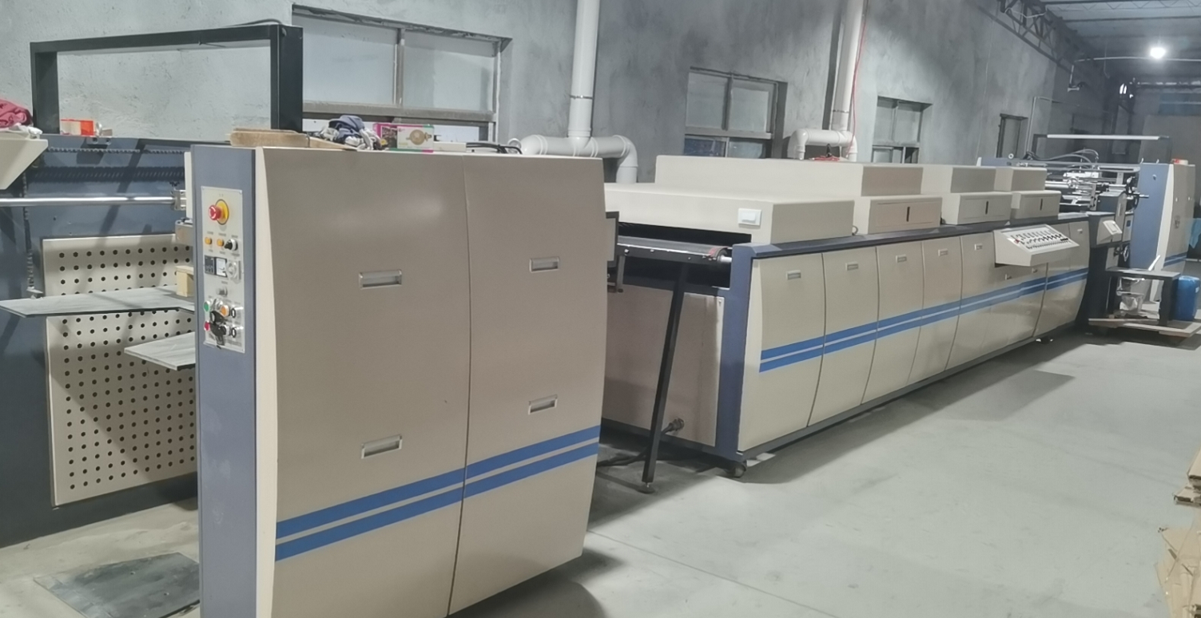
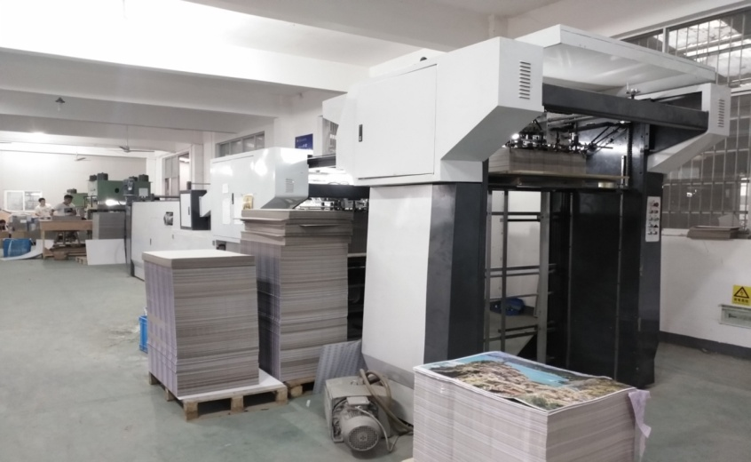
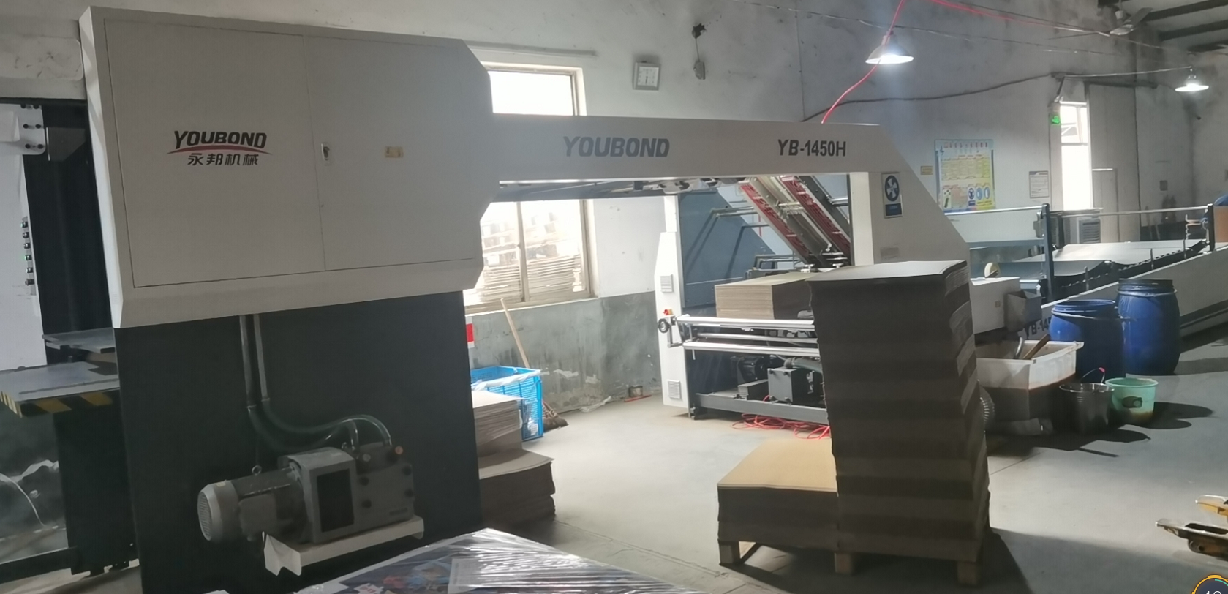
After-printing Equipment
High-speed linening laminating machine
High-speed automatic varnish machine
Automatic fast laminating machine (grey board)
Automatic fast laminating machine (E-flute)
Efficient, fast, can complete the laminating and linening processes at the same time, and can also be operated separately.
Efficient, fast, can complete the process of ordinary water-based varnish, UV varnish, special poker resin varnish。
Efficient and fast, paper and grey board are fed at the same speed at the same time.
Efficient and fast, the paper and E-Flute are fed at the same speed at the same time.

Slide 5
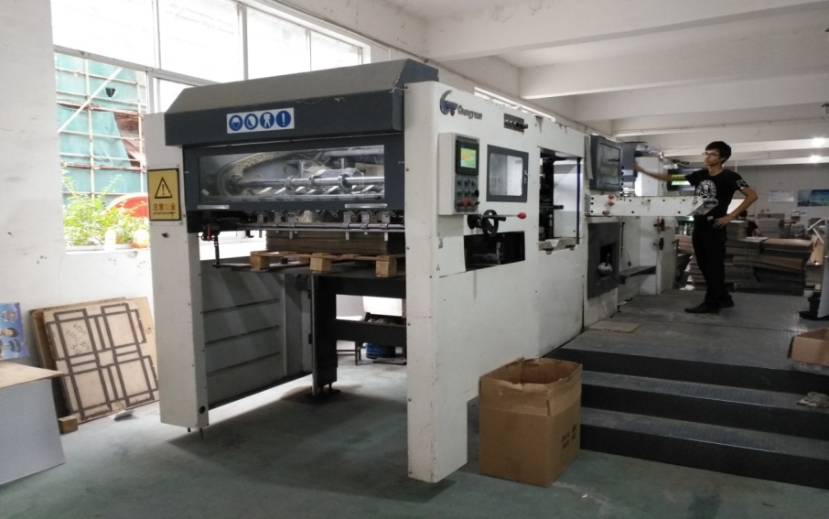
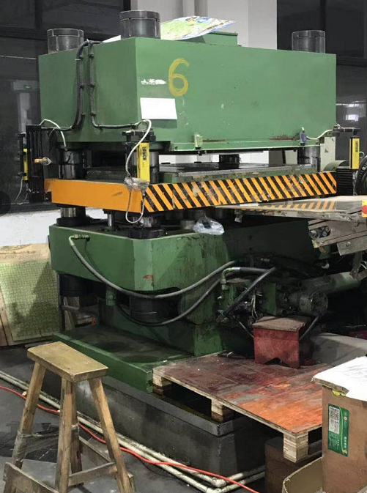
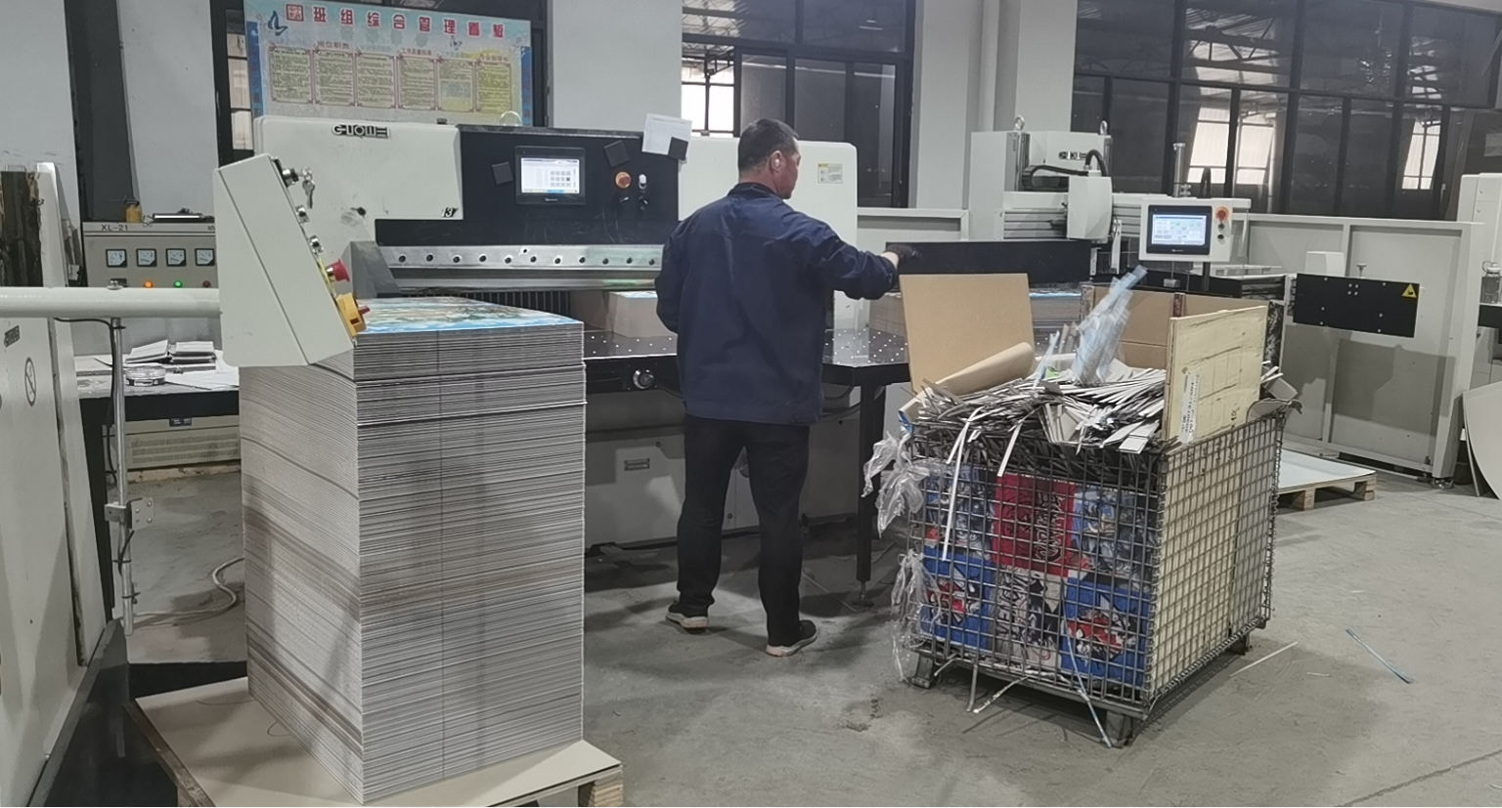
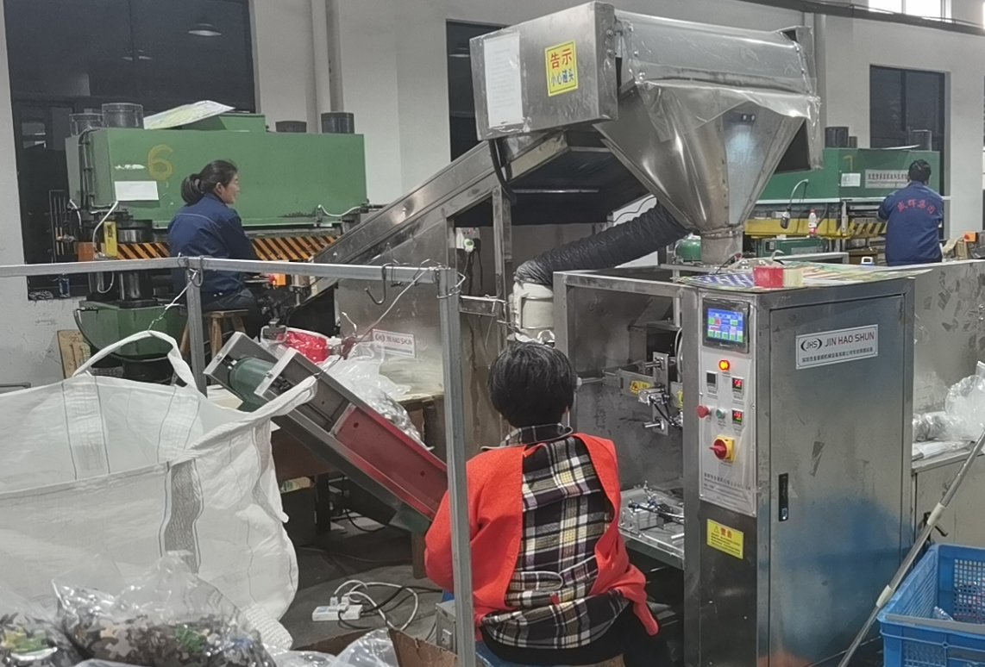
Die-cutting Equipment
Digital display automatic bag breaking and sealing machine
Automatic die-cutting machine (500 tons pressure)
Four-column hydraulic press (800 tons pressure)
Automatic loading and unloading paper cutter
Efficient, fast, large tonnage, enough pressure will not cause continuous cutting problems, the maximum cutting thickness reaches 3.5mm. In addition, infrared protection devices are installed on all sides to improve production safety performance。
Efficient, fast, automatic loading and unloading system greatly saves workers' physical strength, and the daily cutting capacity is increased to twice the efficiency of ordinary paper cutters.
Efficient and fast, to ensure that there is no missing or missing pieces of the puzzle.
Efficient and fast. Can complete the puzzle one-knife forming and cutting operation。

Slide 6
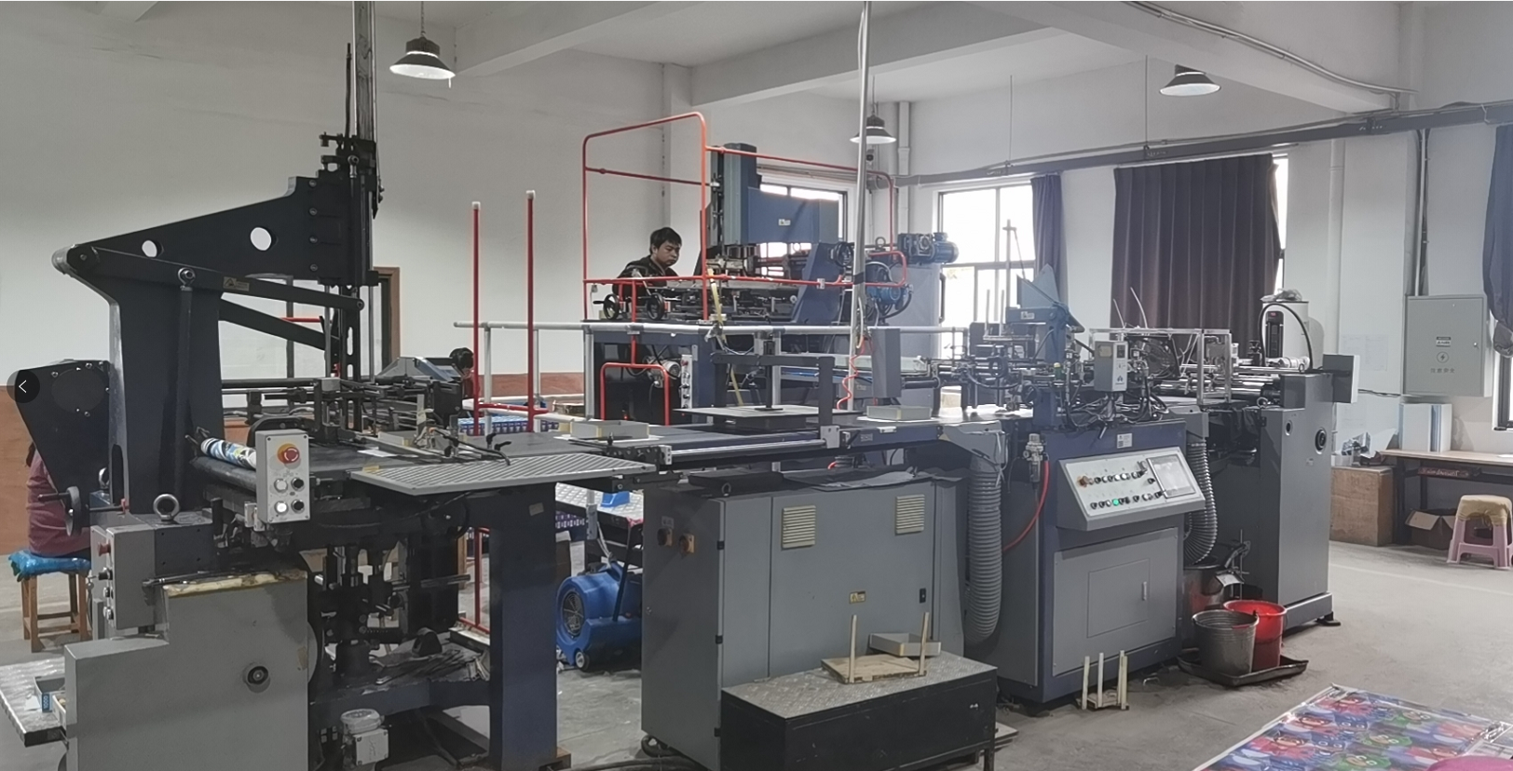
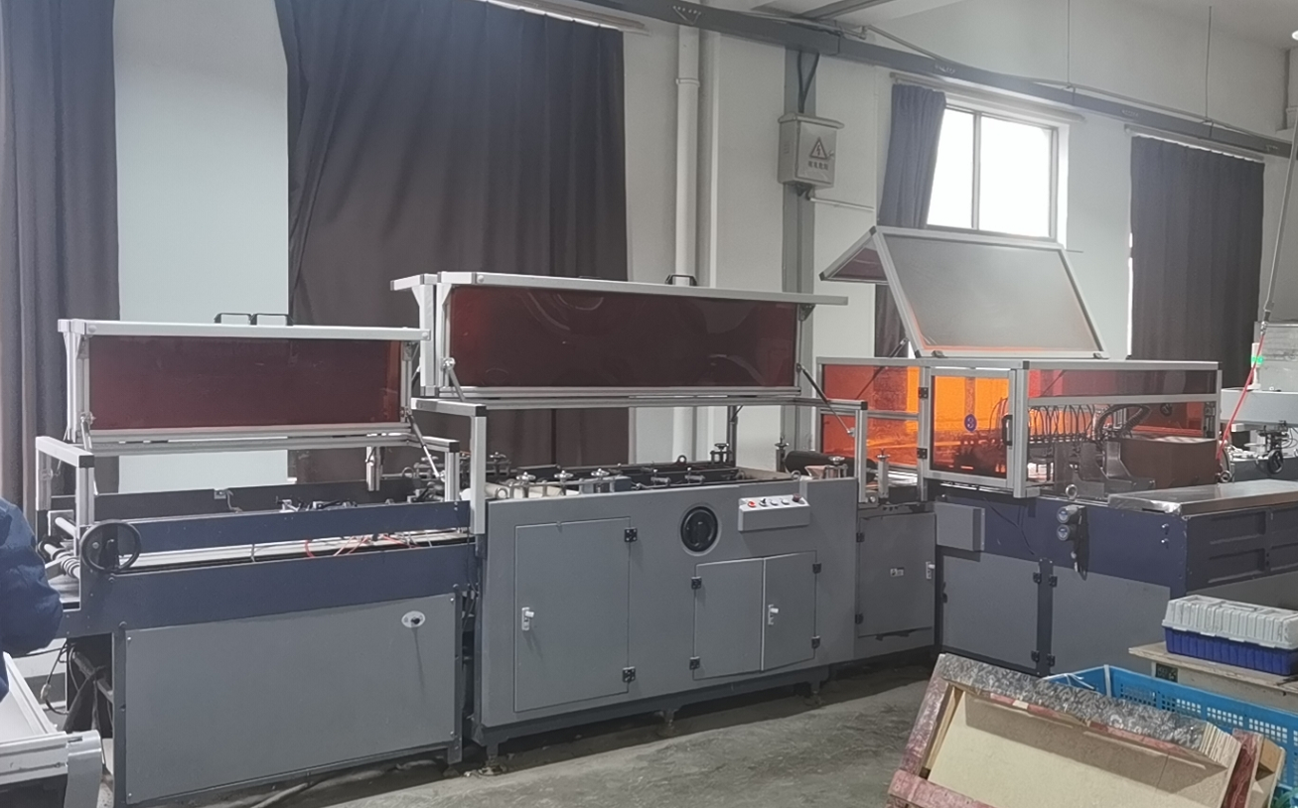
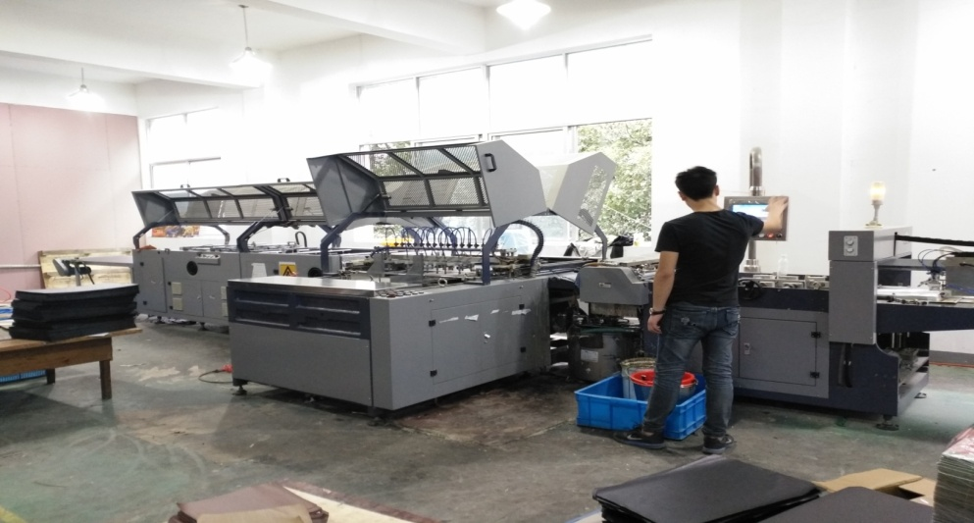
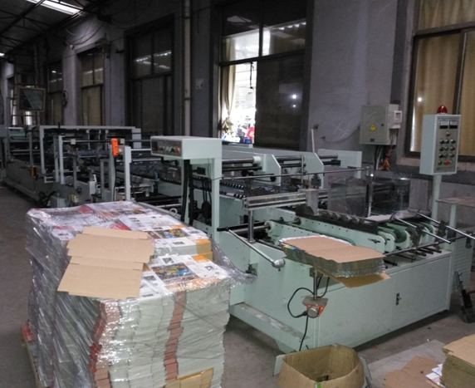
Auto-packaging Equipment
Set-up box automatic forming machine
Game board automatic forming machine
Game board automatic forming machine
Corrugated box automatic bonding machine

Slide 7
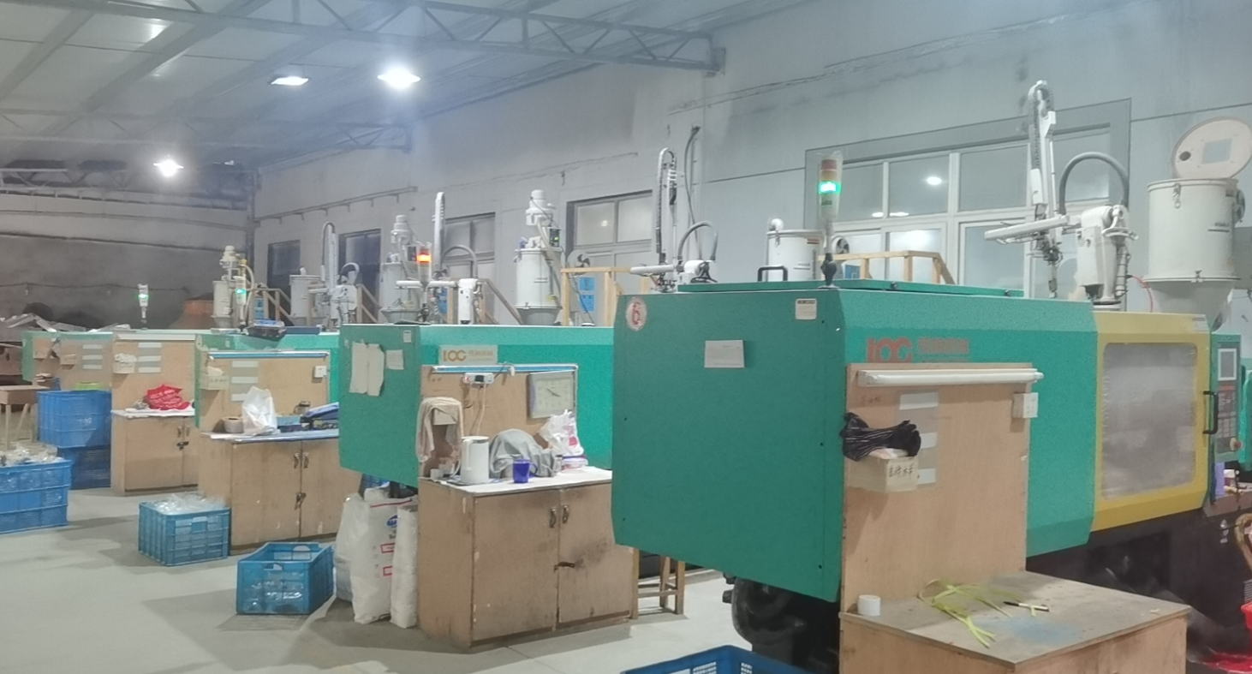
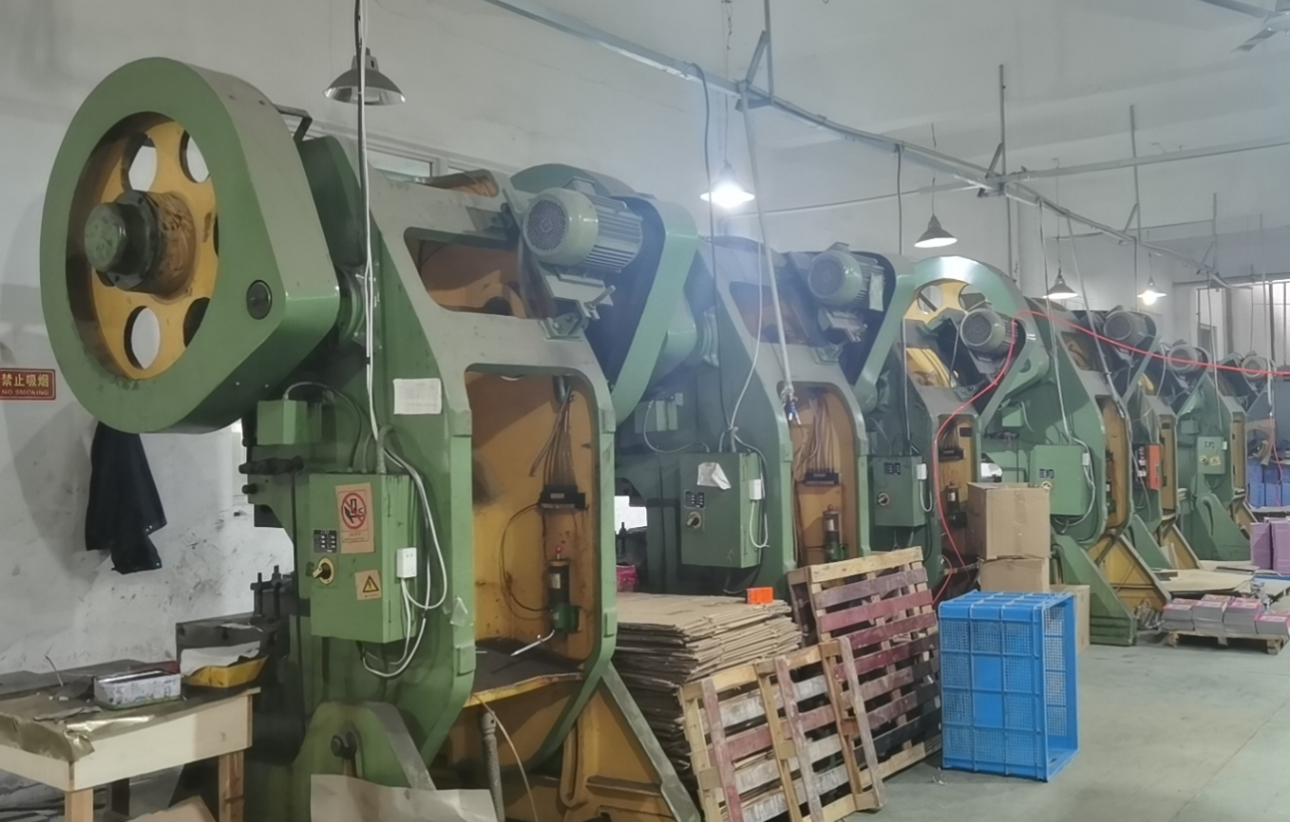
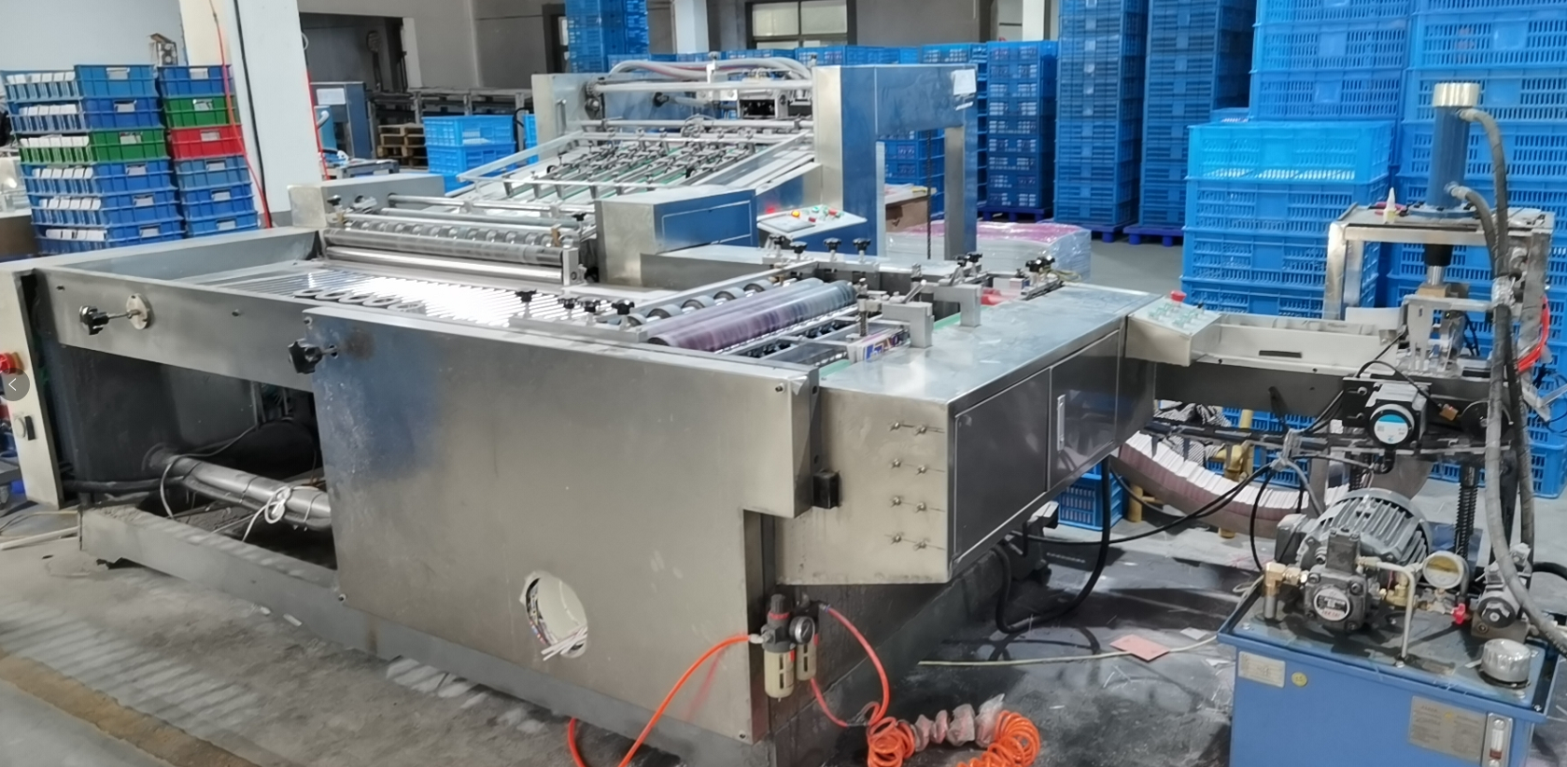
The Other（Injection，Tin box，Game card）
01
02
03
Injection machine
Tin box machine
Game card machine
1，The injection workshop has 12 injection molding machines of each gram weight. All injection molding machines are equipped with manipulators to save labor costs.
2，The tin-making workshop has 57 sets of various tin-making equipment. It can meet the full-line production requirements of various types of tins.
3，In the card licensing workshop, there are three automatic licensing machines, and six various downstream small packaging process equipment. Try to achieve mechanization and save labor costs.

Slide 8
Processing parameters of each equipment
设备编码 | 设备名称 | 设备类型编码 | 工序编码 | 工序名称 | 平均加工速度 | 换单平均时间（分钟）
HKYS-001 | 1号对开印刷机 | A | 2 | 印刷 | 70000/班 | 20
HKYS-002 | 2号四开印刷机 | A | 2 | 印刷 | 60000/班 | 20
HKYS-003 | 3号对开印刷机 | A | 2 | 印刷 | 70000/班 | 20
HKQZ-001 | 1号切纸机 | B | 1 | 切纸 | 100000张 | 5
HKQZ-002 | 2号切纸机 | B | 1 | 切纸 | 100000张 | 5
HKQZ-003 | 3号切纸机 | B | 1 | 切纸 | 50000张 | 5
HKFM-001 | 全自动覆膜压纹机 | A | 3 | 覆膜 | 30000张/班 | 25
HKBW-001 | 全自动裱瓦机 | B | 5 | 裱瓦 | 13000张/班 | 20
HKBK-001 | 全自动裱卡机 | B | 4 | 裱卡 | 16000张/班 | 20
HKYY-001 | 300吨四柱液压机 | B | 6 | 液压 | 4500/班 | 60
HKYY-002 | 300吨四柱液压机 | B | 6 | 液压 | 4500/班 | 60
HKYY-003 | 500吨四柱液压机 | B | 6 | 液压 | 4000/班 | 60
HKYY-004 | 500吨四柱液压机 | B | 6 | 液压 | 4000/班 | 60
HKYY-005 | 500吨四柱液压机 | B | 6 | 液压 | 4000/班 | 60
HKYY-006 | 800吨四柱液压机 | B | 6 | 液压 | 3000/班 | 60
HKYY-007 | 800吨四柱液压机 | B | 6 | 液压 | 3000/班 | 60
HKYY-008 | 800吨四柱液压机 | B | 6 | 液压 | 3000/班 | 60
HKYY-009 | 800吨四柱液压机 | B | 6 | 液压 | 3000/班 | 60
HKDS-001 | 拼图打散机 | C | 6 | 液压 | 跟液压机数据 | 0
HKDS-002 | 拼图打散机 | C | 6 | 液压 | 跟液压机数据 | 0
HKDS-003 | 拼图打散机 | C | 6 | 液压 | 跟液压机数据 | 0
HKQYH-001 | 全自动压痕机 | C | 8 | 压痕 | 13000压/班 | 150
HKQYH-002 | 全自动压痕机 | C | 8 | 压痕 | 13000压/班 | 150
HKSYH-001 | 手动压痕机 | C | 8 | 压痕 | 7500压/班 | 70
HKSYH-002 | 手动压痕机 | C | 8 | 压痕 | 7500压/班 | 70
HKSYH-003 | 手动压痕机 | C | 8 | 压痕 | 7500压/班 | 70
HKSYH-004 | 手动压痕机 | C | 8 | 压痕 | 7500压/班 | 70
HKSYH-005 | 手动压痕机 | C | 8 | 压痕 | 7500压/班 | 70
HKZS-001 | 双盛100克注塑机 | B | 9 | 注塑 | 36秒/模 | 120
HKZS-002 | 双盛100克注塑机 | B | 9 | 注塑 | 25秒/模 | 120
HKZS-003 | 朗格150克注塑机 | B | 9 | 注塑 | 28秒/模 | 120
HKZS-004 | 朗格150克注塑机 | B | 9 | 注塑 | 32秒/模 | 120
HKZS-005 | 朗格200克注塑机 | B | 9 | 注塑 | 37秒/模 | 120
HKZS-006 | 朗格300克注塑机 | B | 9 | 注塑 | 51秒/模 | 120
HKZS-007 | 海天350克注塑机 | B | 9 | 注塑 | 70秒/模 | 120
HKZS-008 | 海天350克注塑机 | B | 9 | 注塑 | 70秒/模 | 120
HKZS-009 | HWAMDE350克注塑机 | B | 9 | 注塑 | 70秒/模 | 120
HKZS-010 | HWAMDE350克注塑机 | B | 9 | 注塑 | 70秒/模 | 120
HKZS-011 | HWAMDE500克注塑机 | B | 9 | 注塑 | 90秒/模 | 120
HKZS-012 | HWAMDE500克注塑机 | B | 9 | 注塑 | 90秒/模 | 120
HKTD-001 | 全自动天地盖成型机 | A | 12 | 天地盖棋板车间 | 4000套/班次 | 90
HKTD-002 | 全自动天地盖成型机 | A | 12 | 天地盖棋板车间 | 4000套/班次 | 90
HKTD-003 | 全自动天地盖成型机 | A | 12 | 天地盖棋板车间 | 4000套/班次 | 90
HKTD-004 | 全自动天地盖成型机 | A | 12 | 天地盖棋板车间 | 4000套/班次 | 90
HKTD-005 | 全自动棋板机 | B | 12 | 天地盖棋板车间 | 4000套/班次 | 30
HKTD-006 | 全自动棋板机 | B | 12 | 天地盖棋板车间 | 4000套/班次 | 30
HKTD-007 | 全自动棋板机 | B | 12 | 天地盖棋板车间 | 4000套/班次 | 30
HKPK-001 | 全自动扑克牌理牌机 | B |  | 扑克牌车间 | 12000副/班次 | 40
HKPK-002 | 全自动扑克牌理牌机 | B |  | 扑克牌车间 | 12000副/班次 | 40
HKPK-003 | 全自动扑克牌理牌机 | B |  | 扑克牌车间 | 12000副/班次 | 40

Slide 9
THANKS！

